Slide 1
Moving IC Design from SoC to Chiplet-based SiP
Gordon Allan, Siemens EDA

Slide 2
Things are changing

Slide 3
Moving IC Design from SoC to Chiplet-based SiP Gordon Allan, Product Manager, Verification IP at Siemens EDA
Many IC design and verification teams are currently transitioning from monolithic integrated SoC ASIC designs to heterogeneous System-in-Package designs.
The new designs must incorporate multiple dies, chiplets, memory dies, chip-to-chip I/O, memory I/F protocols. Front-end design and verification must change a great deal to incorporate the new technologies.
There are new requirements for all stages of development: architecture, design, verification, and integration.
Also new ways of working between design roles and verification roles are necessary, and new iteration cycles must be introduced, necessitating optimized flows and increased use of automation.
Finally, chiplet-based designs require new interface protocols and security features.
Design and verification teams must make major changes and adaptations to move the new approach involving 3DIC and chiplets to the mainstream, roll out the new interfaces, and adapt roles to succeed while still meeting demands for ever faster time to market.

Slide 4
Some things remain the same

Slide 5
Evolution of IC Integration .. 1979
 | 1979 | 1992 | 1995 | 1999 | 2023+
Module Sources | Schematics with MOS sized transistors | Standard cell designs – schematic or RTL | RTL synthesis to standard cell library | RTL synthesis to standard cell library | RTL/HLS synthesis to standard cell library
Module Interconnect | Discrete wires/buses | Manual bus interconnect, tristate buses on chip with bus keepers | Automated internal bus, IO and protocol interconnect, emerging standards, no 3-state | XML-descriptors to abstract module and chip level interconnect, fast standard buses | Multiple automation flows for SiP and SoC Standard chip-to-chip SerDes / UCIe protocols
IC level Integration | Physical layout maro placement and hookup | Combo of front-end schematic integration and layout hard macros | Front end RTL integration plus special/analog cells | Front end RTL integration plus special/analog cells | Physical Chiplet placement and hookup
IC level Verification | SPICE | Verilog gate-level | Verilog RTL-level + some automation | Verilog + protocol VIPs + XML automation | SV / UVM simulation + Emulation/prototyping
IC physical flow / roles | Frontend team = Backend team | Mixed team Collaboration | Integrated RTL plus automated constraint files | Advanced floorplanning | Multiple die each floorplanned
IC package flow | Ad hoc | Ad Hoc | Automated | Automated | 2.5D or 3DIC packages with various Substrate, EMIB, Interposer flows
IC test | Analog | Muxed modules | JTAG and Scan/ATPG | JTAG, optimized Scan | JTAG, Streaming Scan
Module Reuse / Market | (none) | (none) | Library of reusable Modules with Integration Attributes / Hints | Library and ecosystem of reusable modules with XML descriptors / attributes | Choice: on-chip modules from library ecosystem or off-chip chiplets from 2.5D/3DIC marketplace

Slide 6
Evolution of IC Integration .. 1979 🡪 1992
 | 1979 | 1992 | 1995 | 1999 | 2023+
Module Sources | Schematics with MOS sized transistors | Standard cell designs – schematic or RTL | RTL synthesis to standard cell library | RTL synthesis to standard cell library | RTL/HLS synthesis to standard cell library
Module Interconnect | Discrete wires/buses | Manual bus interconnect, tristate buses on chip with bus keepers | Automated internal bus, IO and protocol interconnect, emerging standards, no 3-state | XML-descriptors to abstract module and chip level interconnect, fast standard buses | Multiple automation flows for SiP and SoC Standard chip-to-chip SerDes / UCIe protocols
IC level Integration | Physical layout maro placement and hookup | Combo of front-end schematic integration and layout hard macros | Front end RTL integration plus special/analog cells | Front end RTL integration plus special/analog cells | Physical Chiplet placement and hookup
IC level Verification | SPICE | Verilog gate-level | Verilog RTL-level + some automation | Verilog + protocol VIPs + XML automation | SV / UVM simulation + Emulation/prototyping
IC physical flow / roles | Frontend team = Backend team | Mixed team Collaboration | Integrated RTL plus automated constraint files | Advanced floorplanning | Multiple die each floorplanned
IC package flow | Ad hoc | Ad Hoc | Automated | Automated | 2.5D or 3DIC packages with various Substrate, EMIB, Interposer flows
IC test | Analog | Muxed modules | JTAG and Scan/ATPG | JTAG, optimized Scan | JTAG, Streaming Scan
Module Reuse / Market | (none) | (none) | Library of reusable Modules with Integration Attributes / Hints | Library and ecosystem of reusable modules with XML descriptors / attributes | Choice: on-chip modules from library ecosystem or off-chip chiplets from 2.5D/3DIC marketplace

Slide 7
Evolution of IC Integration .. 1979 🡪 1992 🡪 1994
 | 1979 | 1992 | 1994 | 1999 | 2023+
Module Sources | Schematics with MOS sized transistors | Standard cell designs – schematic or RTL | RTL synthesis to standard cell library | RTL synthesis to standard cell library | RTL/HLS synthesis to standard cell library
Module Interconnect | Discrete wires/buses | Manual bus interconnect, tristate buses on chip with bus keepers | Automated internal bus, IO and protocol interconnect, emerging standards, no 3-state | XML-descriptors to abstract module and chip level interconnect, fast standard buses | Multiple automation flows for SiP and SoC Standard chip-to-chip SerDes / UCIe protocols
IC level Integration | Physical layout maro placement and hookup | Combo of front-end schematic integration and layout hard macros | Front end RTL integration plus special/analog cells | Front end RTL integration plus special/analog cells | Physical Chiplet placement and hookup
IC level Verification | SPICE | Verilog gate-level | Verilog RTL-level + some automation | Verilog + protocol VIPs + XML automation | SV / UVM simulation + Emulation/prototyping
IC physical flow / roles | Frontend team = Backend team | Mixed team Collaboration | Integrated RTL plus automated constraint files | Advanced floorplanning | Multiple die each floorplanned
IC package flow | Ad hoc | Ad Hoc | Automated | Automated | 2.5D or 3DIC packages with various Substrate, EMIB, Interposer flows
IC test | Analog | Muxed modules | JTAG and Scan/ATPG | JTAG, optimized Scan | JTAG, Streaming Scan
Module Reuse / Market | (none) | (none) | Library of reusable Modules with Integration Attributes / Hints | Library and ecosystem of reusable modules with XML descriptors / attributes | Choice: on-chip modules from library ecosystem or off-chip chiplets from 2.5D/3DIC marketplace

Slide 8
Evolution of IC Integration .. 1979 🡪 1992 🡪 1994 🡪 1999
 | 1979 | 1992 | 1995 | 1999 | 2023+
Module Sources | Schematics with MOS sized transistors | Standard cell designs – schematic or RTL | RTL synthesis to standard cell library | RTL synthesis to standard cell library | RTL/HLS synthesis to standard cell library
Module Interconnect | Discrete wires/buses | Manual bus interconnect, tristate buses on chip with bus keepers | Automated internal bus, IO and protocol interconnect, emerging standards, no 3-state | XML-descriptors to abstract module and chip level interconnect, fast standard buses | Multiple automation flows for SiP and SoC Standard chip-to-chip SerDes / UCIe protocols
IC level Integration | Physical layout maro placement and hookup | Combo of front-end schematic integration and layout hard macros | Front end RTL integration plus special/analog cells | Front end RTL integration plus special/analog cells | Physical Chiplet placement and hookup
IC level Verification | SPICE | Verilog gate-level | Verilog RTL-level + some automation | Verilog + protocol VIPs + XML automation | SV / UVM simulation + Emulation/prototyping
IC physical flow / roles | Frontend team = Backend team | Mixed team Collaboration | Integrated RTL plus automated constraint files | Advanced floorplanning | Multiple die each floorplanned
IC package flow | Ad hoc | Ad Hoc | Automated | Automated | 2.5D or 3DIC packages with various Substrate, EMIB, Interposer flows
IC test | Analog | Muxed modules | JTAG and Scan/ATPG | JTAG, optimized Scan | JTAG, Streaming Scan
Module Reuse / Market | (none) | (none) | Library of reusable Modules with Integration Attributes / Hints | Library and ecosystem of reusable modules with XML descriptors / attributes | Choice: on-chip modules from library ecosystem or off-chip chiplets from 2.5D/3DIC marketplace

Slide 9
Fast Forward to Today’s SiPs

Slide 10
3DIC and Chiplets – Comparison with traditional monolithic SoC
PCB Area
SiP Package
8x 110G PHY
110G PHY
110G PHY
110G PHY
110G PHY
110G PHY
110G PHY
110G PHY
110G PHY
SoC Die
GPIO
Function A
Analog
GPIO
ASIC DIE A
Analog
Memory A
DSP
HBM A
DSP
GPIO
Function B
DDR5
I/F
GPIO
ASIC DIE B
HBM B
DDR5
Memory B
56G PHY
56G PHY
Single-die SoC, single technology node,
Simpler, traditional ASIC arch + flow
Most functions/PHYs/memory on-chip
Some may be relegated to off-chip PCB
Multi-chiplet System-in-Package (AKA 3DIC)
All functions/PHYs/fast memory within SiP
15x chiplets/dies (ASICs, HBM, PHYs)
Bandwidth/latency/power/area benefits

Slide 11
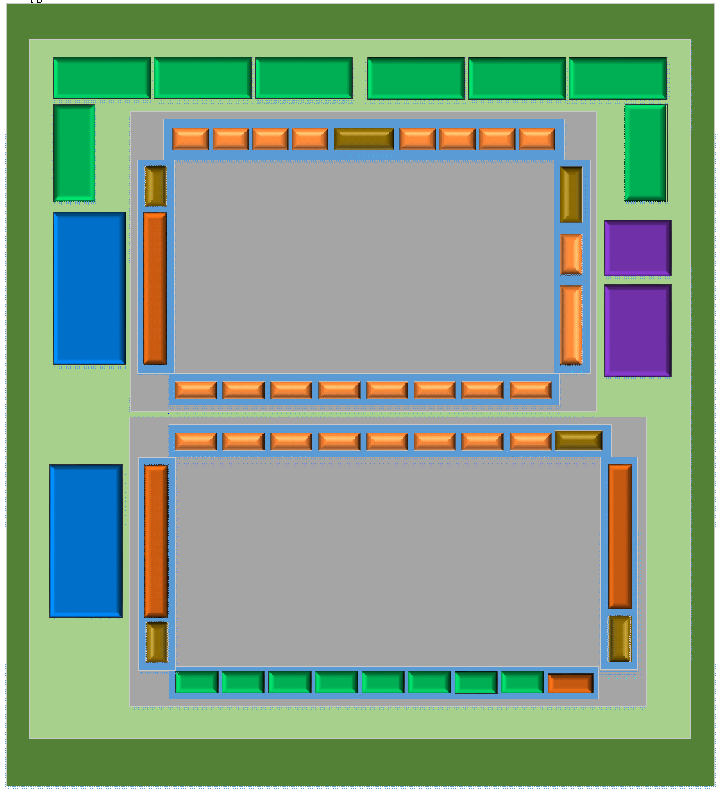
3DIC and Chiplets – Floorplanning the package
Larger Serdes “Beach Front” (vs ASIC size limit)
SiP Package
PHY Rotation (not feasible inside ASIC)
110G PHY
110G PHY
110G PHY
110G PHY
110G PHY
110G PHY
110G PHY
110G PHY
Integrate High Performance Analog IP Chiplets
GPIO
ASIC DIE A
Analog
Die-to-Die Protocols
HBM A
DSP
Integrate High Performance Processor Chiplets
GPIO
ASIC DIE B
Integrate Ultra High Bandwidth Memories in SIP
HBM B
DDR5
Disaggregate Ultra-large die to yieldable dimensions
56G PHY
Can still support external memory interface
Test Strategy
Can still support integrated Serdes ASIC IP

Slide 12
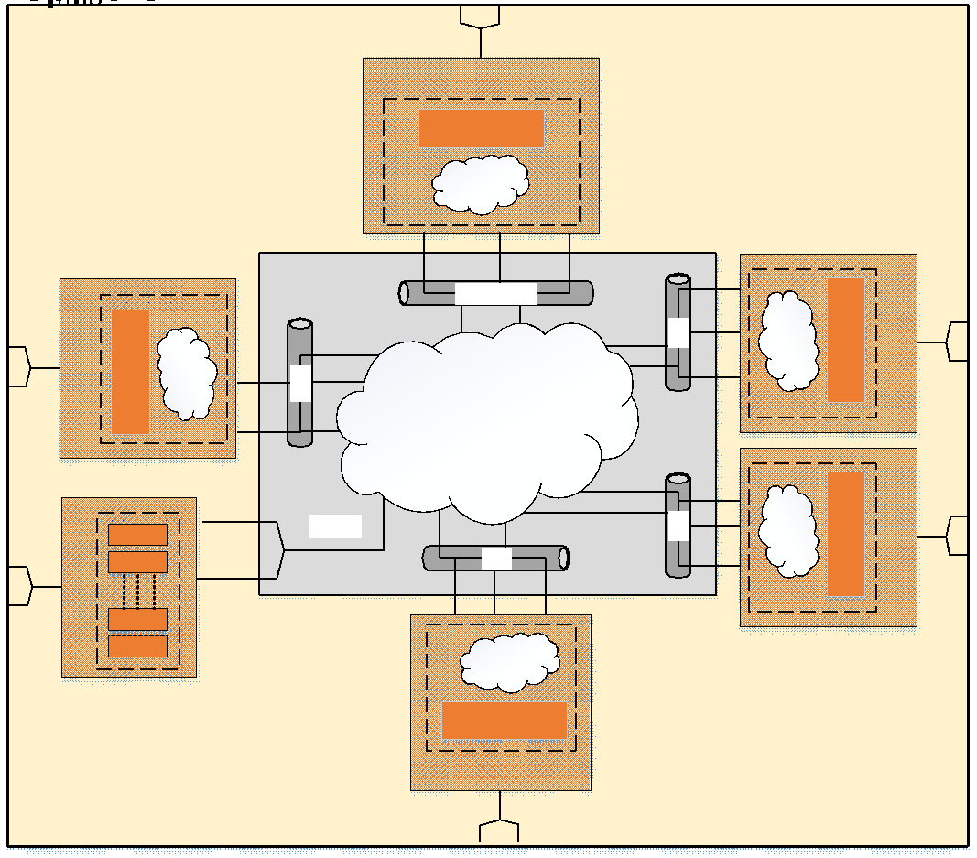
3DIC and Chiplets – Die-to-Die Interface Abstraction

Slide 13
Change: New Architectural Variables and Decisions

Slide 14
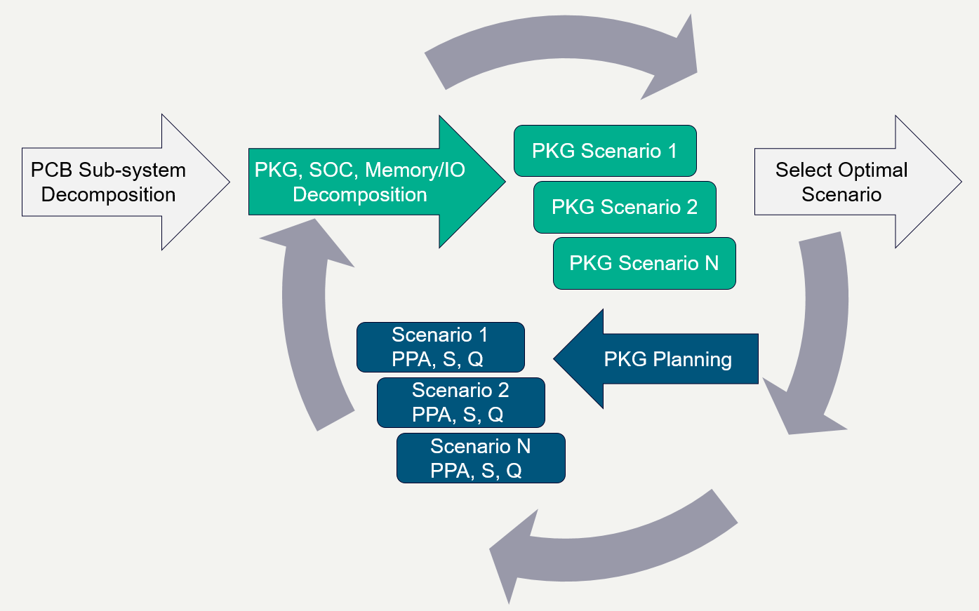
The role of STCO – System Technology Co-optimization
RTL Architect Defines SiP Level connectivity using Generic Memory/IO Libraries
Package Architect Maps these to Technology/IP Specific Lib Scenarios
Assess Pros/Cons of each scenario using co-design/analysis flow

Slide 15
What EDA can do to support design innovation / experimentation – Enabling scaling across technologies, designs, systems, abstractions
Tool performance scaling
Design for manufacturability
Test and yield
Computational lithography
Enable Technology Scaling
New Nodes and 3D
High level synthesis
High performance place and route
Power optimization
3D integration
Enable Design Scaling
Taking advantage of Integration
Hardware for application scale performance
Integrated simulation engines and co-modeling
Analog mixed signal
Lifecycle management
Enable System Scaling
Validation and the digital twin

Slide 16
Change: New Protocol / Memory Interface Standards

Slide 17
What EDA can do to support innovation – Functional Verification aspects – Verification IP
SoC flow
Verify off-chip IO interfaces - PCIe, USB, Ether, Serial, HDMI, etc
Verify off-chip MEM interfaces - DDR, Flash, etc
Verify subsys/block internal buses - AMBA AXI, AHB, APB, etc
Verify overall behavior & performance scenarios
3DIC flow
Initial high level functionality checks for chosen 3DIC arch
Verify off-package IO interfaces - PCIe, USB, Ether, Serial, HDMI
Verify off-package MEM interfaces - DDR, Flash
Verify die-to-die IO interfaces - USR, XSR, AIB, HBI, BOW, UCIe
Verify internal MEM interfaces - HBM2/3
Verify subsys/block internal buses - AMBA AXI, AHB, APB
Verify overall behavior & performance scenarios
All of these require Verification IP and a productive automated flow
SiP Package
110G PHY
110G PHY
110G PHY
110G PHY
110G PHY
110G PHY
110G PHY
110G PHY
GPIO
ASIC DIE A
Analog
HBM A
DSP
GPIO
ASIC DIE B
HBM B
DDR5
56G PHY

Slide 18
What EDA can do to support innovation – Productivity improvements for complex protocol verification
DUT – TB Connections
Connect DUT pins to VIP signals
Connect Clock & Reset
Configure parameters
VIP Configuration
VIP configured according to design’s characteristics
PCIe Link Training
VIP runs link training based on configuration
Link trained to desired speed
PCIe Enumeration
Run bus enumeration sequence for Device discovery and setting Device capabilities
Application Verification
Users able to write device specific stimulus
Automation == Productivity
Getting started in minutes not days
Enable experimentation / analysis

Slide 19
What EDA can do to support innovation – Verification Solution Architecture for Complex Protocols: CXL, PCIe, others
Type 3
Host
Use Models
CXL QVIP User API Layer
Load/Store
CXL.Cache
H2D_Req, H2D_Data, H2D_Rsp
D2H_Req, D2H_Data, D2H_Rsp
CXL.Mem
M2S_Req, M2S_RwD, S2M_NDR, S2M_DRS
CXL.IO/PCIe
IO Request, Completion
Type 2
Type 1
CXL.io/ PCIe API
CXL.Cache API
CXL.mem API
Load/ Store API
CXL BFM
Coherency Engine
Memory
Cache
CXL.io/PCIe Transaction Layer
CXL.cache/CXL.mem Transaction Layer
Backdoor access: memory & cache
Configurable Cache size
CXL.io/PCIe Link Layer
CXL.cache/CXL.mem Link Layer
Callback API at each Layer
Ability to track packets thru CXL Layer
Update packet content
CXL ARB/MUX
Configuration
BFM Configuration
Configuration Space
LTSSM counters/timeouts
CXL/PCIe Logical PHY

Slide 20
Change: New HW Security Requirements

Slide 21
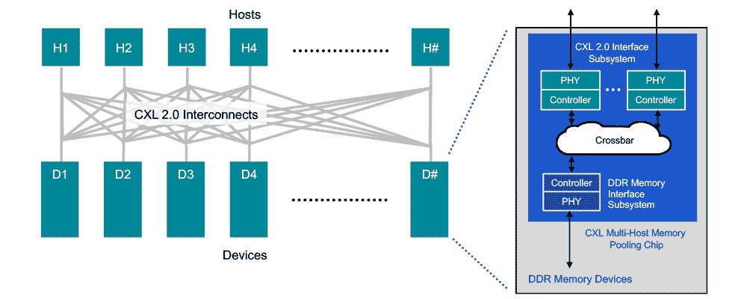
What EDA can do to support innovation – Security – Verification of secure chip-to-chip protocols PCIe6, CXL3
The CXL interconnect moves high value system data across the link.
As with all high value data, there is a need to protect that data from attackers
Every chip in a system is a potential target for physical attack, with CXL interconnect being a specific target
Adversaries can attempt to breach system security e.g. by use of a ‘sniffing’ device to attack systems
CXL and PCIe have IDE (Integrity and Data Encryption) capability in CXL2.0 as an optional feature
256-bit AES-GCM encryption ensures data confidentiality, integrity, and replay protection
Threat Model:
Logic Analyzer/ Purpose built Interposer devices
Rogue Retimers
Malicious Switches

Slide 22
Interconnect Security – CXL/PCIe IDE Verification Considerations
CXL/PCIe6 verification is already complicated enough:
IDE Security brings new verification requirements to PCIe/CXL:
Multiple Streams of link IDE
Mix of IDE
and non IDE TLPs
Aggregation
of IDE TLPs
PCRC
generation & validation
AES-GCM Key Refresh
Errors e.g.
secure/insec transition
Containment vs Skid mode
Truncated MAC
Symmetric/ Asymmetric Secure Session
Multiple Digital Signature Algorithms
Multiple Hash Algorithms
Multiple Encryption Algorithms
Bypass IDE Key Mgmt
Bypassing Secure Session

Slide 23
Change: New Design/Verification Scopes and Interactions

Slide 24
New Interactions between Design / Integrator / Verification Different abstractions and simplifications possible

Slide 25
Evolution of IC Integration .. 1979 🡪 1992 🡪 1994 🡪 1999 🡪 2023+
 | 1979 | 1992 | 1994 | 1999 | 2023+
Module Sources | Schematics with MOS sized transistors | Standard cell designs – schematic or RTL | RTL synthesis to standard cell library | RTL synthesis to standard cell library | RTL/HLS synthesis to standard cell library
Module Interconnect | Discrete wires/buses | Manual bus interconnect, tristate buses on chip with bus keepers | Automated internal bus, IO and protocol interconnect, emerging standards, no 3-state | XML-descriptors to abstract module and chip level interconnect, fast standard buses | Multiple automation flows for SiP and SoC Secure Standard chip-to-chip SerDes / UCIe protocols
IC level Integration | Physical layout maro placement and hookup | Combo of front-end schematic integration and layout hard macros | Front end RTL integration plus special/analog cells | Front end RTL integration plus special/analog cells | Physical Chiplet placement and hookup with Secure Interconnect
IC level Verification | SPICE | Verilog gate-level | Verilog RTL-level + some automation | Verilog + protocol VIPs + XML automation | SV / UVM simulation + Emulation/prototyping
IC physical flow / roles | Frontend team = Backend team | Mixed team Collaboration | Integrated RTL plus automated constraint files | Advanced floorplanning | Multiple die each floorplanned
IC package flow | Ad hoc | Ad Hoc | Automated | Automated | 2.5D or 3DIC packages with various Substrate, EMIB, Interposer flows
IC test | Analog | Muxed modules | JTAG and Scan/ATPG | JTAG, optimized Scan | JTAG, Streaming Scan
Module Reuse / Market | (none) | (none) | Library of reusable Modules with Integration Attributes / Hints | Library and ecosystem of reusable modules with XML descriptors / attributes | Choice: on-chip modules from library ecosystem or off-chip chiplets from 2.5D/3DIC marketplace

