Slide 1
Bringing High Performance High Capacity Persistent Memory to Chiplets
Bill Gervasi
Principal Systems Architect
bilge@nantero.com

Slide 2
Ah, those fabric wars, weren’t they fun?
CXL
They kept the industry fragmented for years!

Slide 3
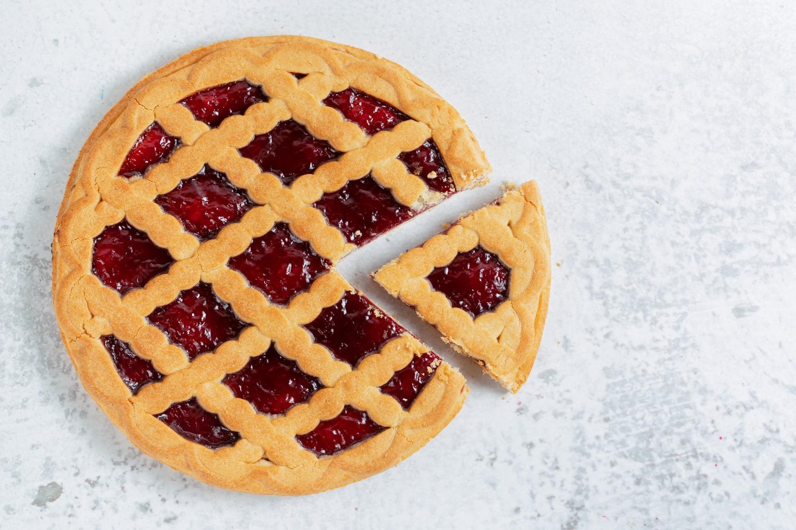
I am a fan of standards (good trait for a JEDEC chair, don’t you think?)
All those proprietary solutions were tasty little tarts, but kept people from baking an entire pie

Slide 4
One great thing about fabrics is how they standardize solutions
We’re all excited to offer new expansion options for systems
Memory expansion
I/O expansion
Storage expansion
Application accelerators
But let’s learn from history…

Slide 5
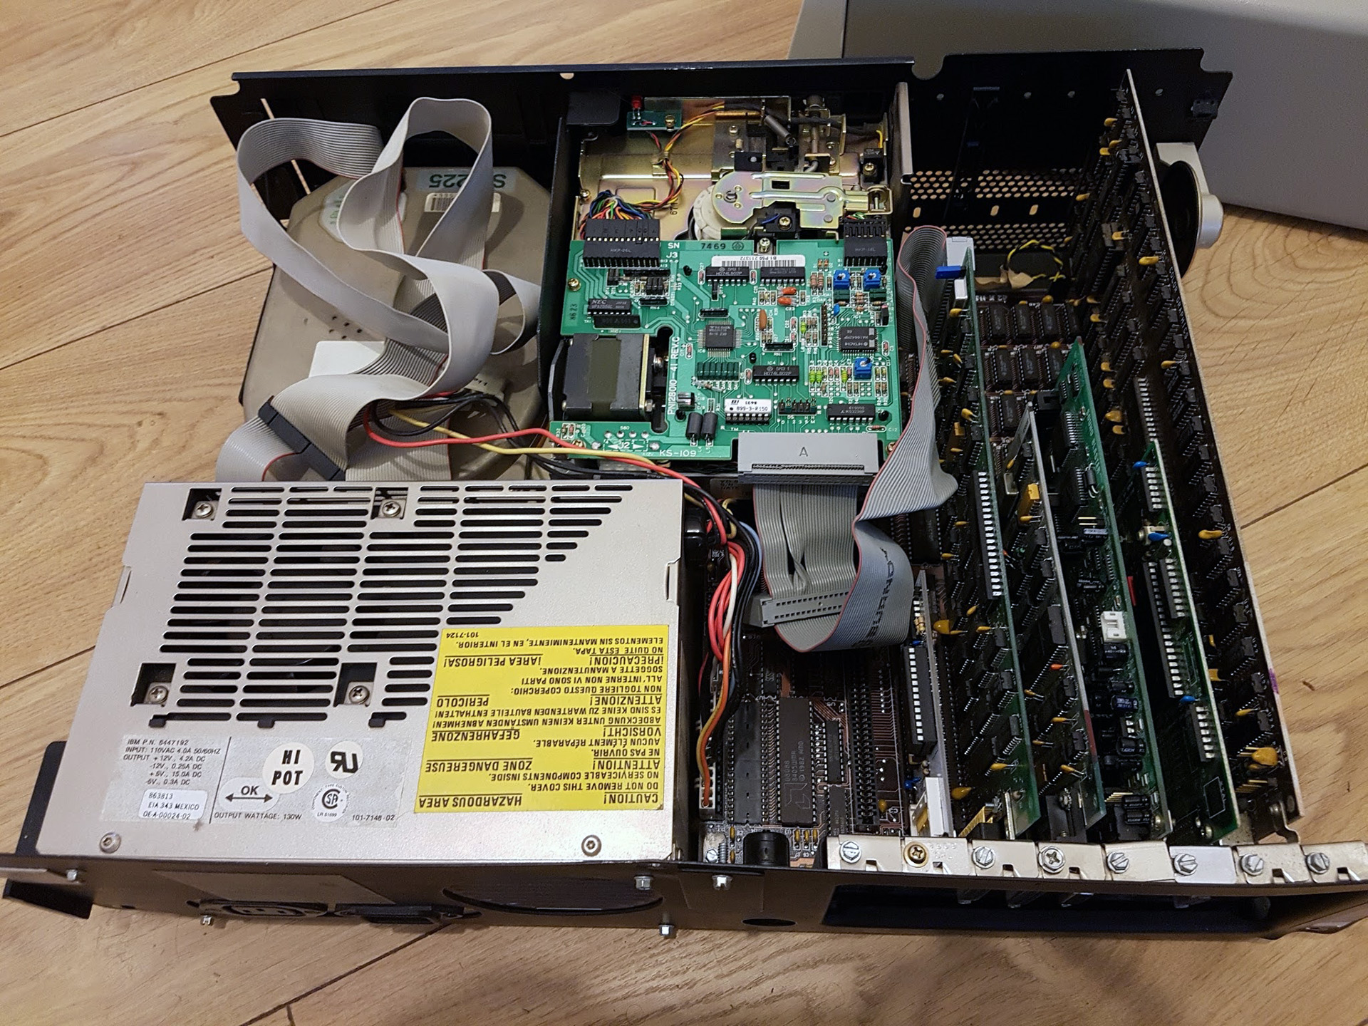
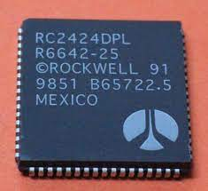
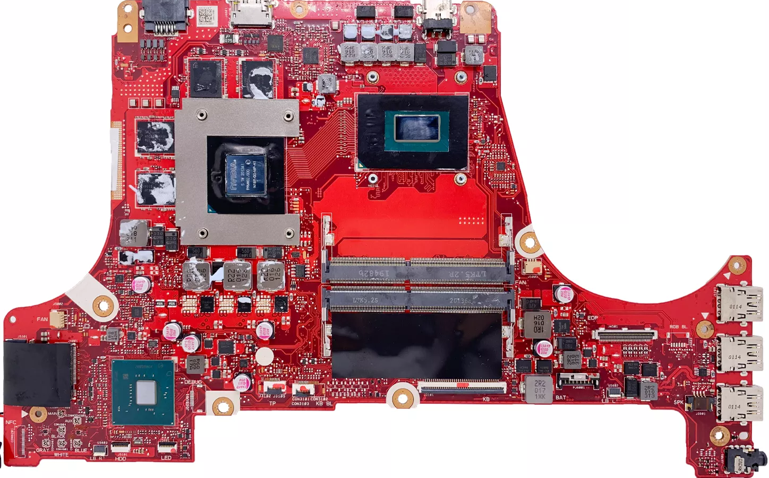
A word of caution…
1980s PC had distributed processing
DSPs for audio, graphics, modem, etc
Price: $5000
Power supply: 65W
Circuit consolidation reduced the system complexity
As the pendulum swings back
Expect higher cost
Smart expansion is essential
Price: $250
Power supply: 280W

Slide 6
Partitioning isn’t the only reason for chiplets
Another aspect of chiplets is functional incrementalism
xPU
New features can be optional placements
Chiplet bus
New
Feature
Example: AI acceleration
xPU with new feature
When the concept is proven move it into main xPUs

Slide 7
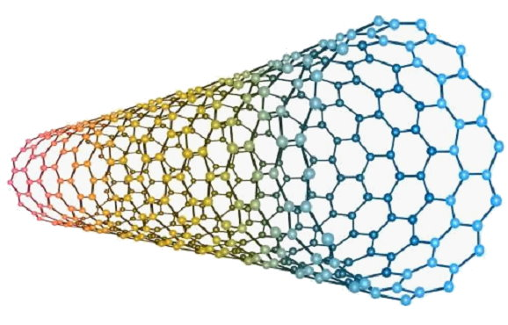
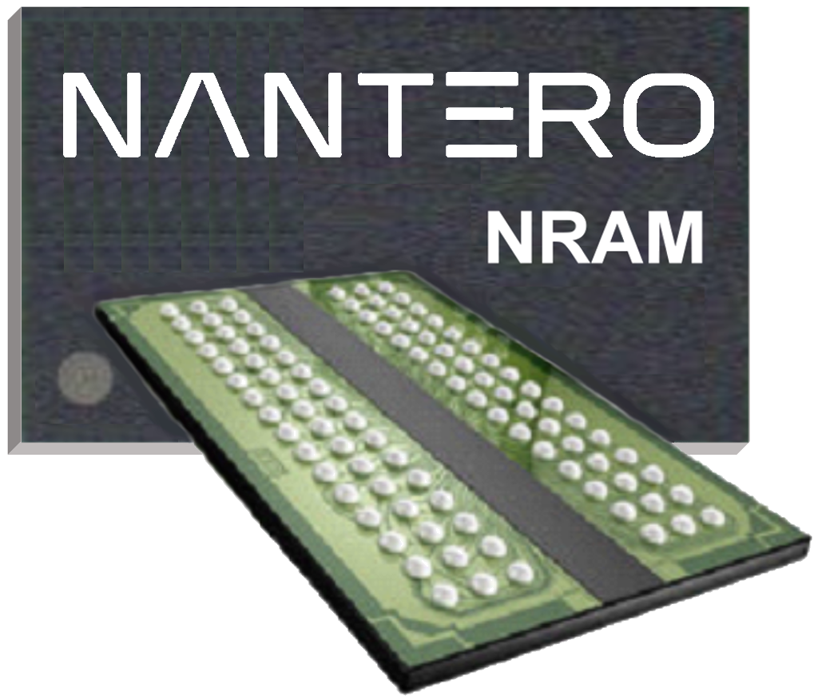
Our solution NRAM® is a non-volatile memory using carbon nanotubes
Standards efforts are under way to interface CXL with DDR family memory
NRAM will adopt this interface

Slide 8
CXL Type 3
Memory Controller
IP blocks for a CXL Type 3
Memory controller are common
Configurable interfaces include
PCIe or UCIe x4 through x64
Component or chiplet
DDR5 NRAM® 1x40 through 4x40
SPI Port
Firmware
Microcontroller
JTAG
DDR5 Port 0
DDR5 NRAM
DDR5 Port 1
DDR5 NRAM
Local Memory
Voltage Regulator
CXL
Local System
Management
Bus
xCIe
Voltage Regulator
Host System
Management
Bus
GPIO
LED
We love that the CXL-UCIe consistency allows quick development for wider market application

Slide 9
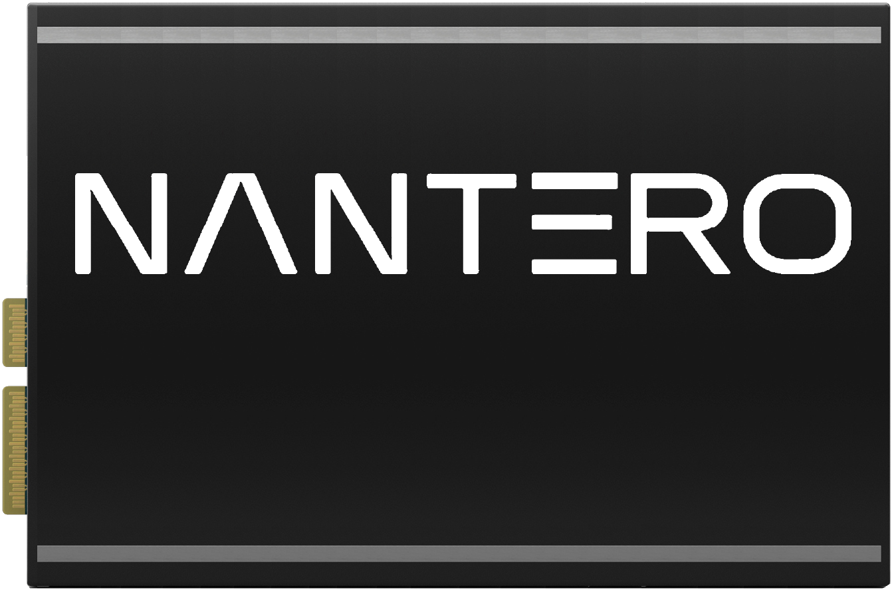
CXL NRAM
Controller
Feeding the beast… massive bulk storage for memory pools
32GB all the way up to 8TB of DRAM-class non-volatile memory

Slide 10
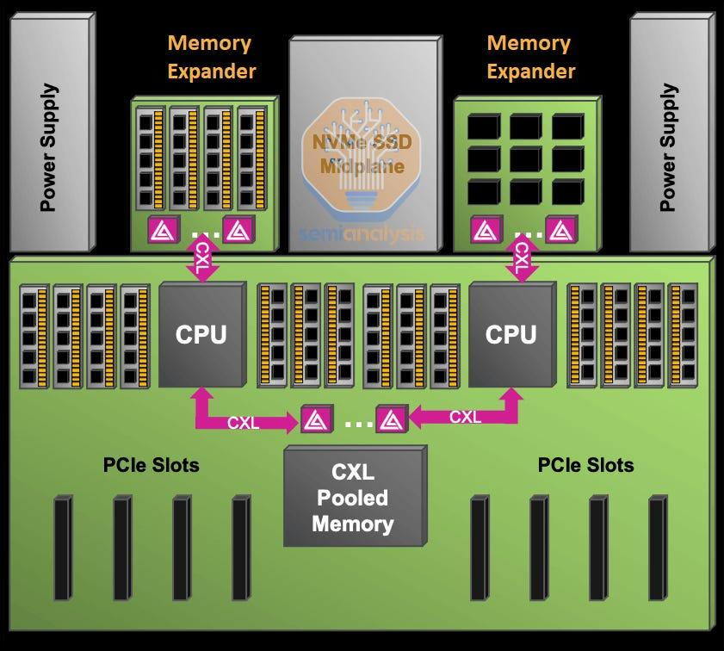
Dedicating a CXL memory module to each CPU is a nice expansion, but…
…not the most power or cost efficient solution
Hence, memory pooling is a more likely common configuration to amortize the investment

Slide 11
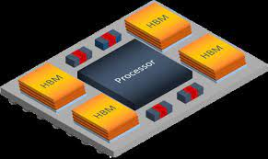
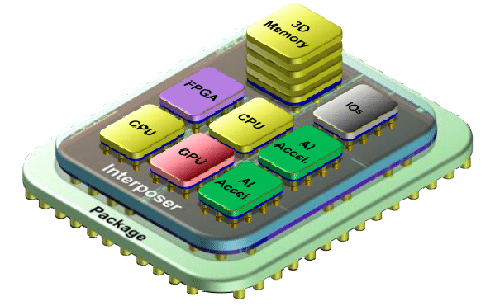
Chiplet Summit exists because fabrics make sense at the package level as well
With single processors, direct connect to memory such as HBM makes sense
However, when things get heterogenous, a fabric solution makes more sense

Slide 12
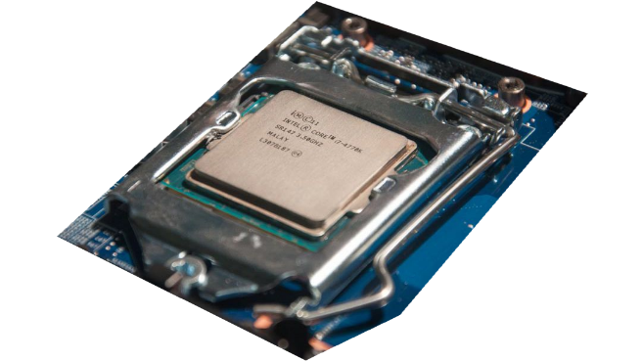
DDR SDRAM
Run
Checkpoint
However, HBM doesn’t solve a couple of big problems
DDR SDRAM
Run
Checkpoint
DDR SDRAM
Run
DDR SDRAM
Checkpoint
Loss of data on power failure which is why we do checkpointing
Run
DDR
Data is moved over buses which can be snooped
PCIe

Slide 13
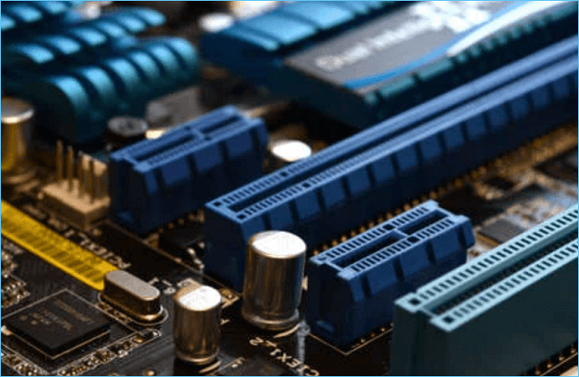
Customer Quote:
My password is…
Once you move unencrypted data over an external bus,
You’ve lost the game

Slide 14
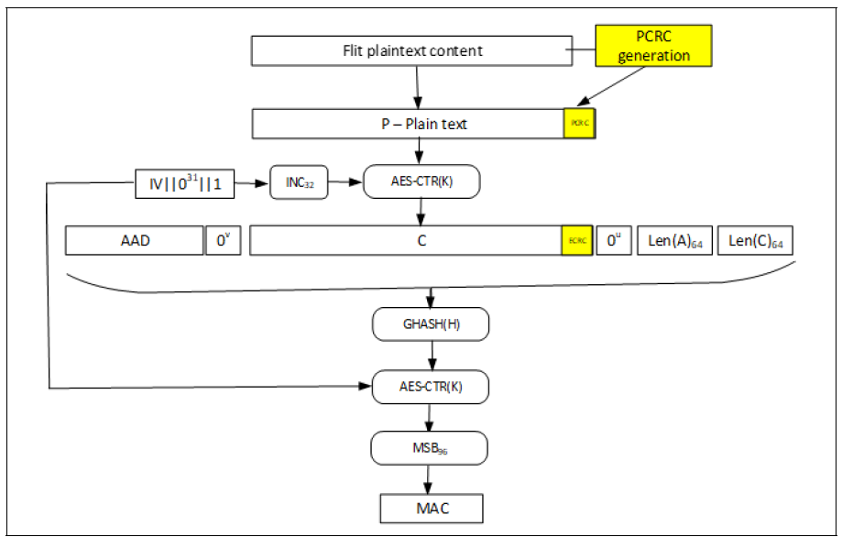
The good news is that CXL gets it…
Integrity and Data Encryption (IDE) supported in CXL
The bad news is TANSTAAFL*…
Performance is negatively
impacted by IDE
* There Ain’t No Such Thing As A Free Lunch

Slide 15
The logical solution is to add on-chip memory class storage
On-Chip Non-Volatile Memory
Reasonably large (e.g., 32GB)
NV memory mounted as DRAM
Chiplet available as a fabric resource that can be pooled for all devices on the package

Slide 16
Porting CXL solutions to UCIe enable a quick time to market for advanced memory solutions
8-16GB NRAM
UCIe NRAM
Controller
Isolating secure data traffic from standard system traffic improves security & improves performance
Fabric
xPU
xPU
xPU
xPU
xPU
Secure data can be pre-loaded into NRAM during manufacturing

Slide 17
Summary
Coherence between CXL and UCIe is great – allows IP reuse
Memory pooling is essential to constrain power and cost
Memory class storage adds significant capabilities to systems
On-chip NVM allows new levels for data security

Slide 18
Thank you for your time
Bill Gervasi
Principal Systems Architect
bilge@nantero.com

