Slide 1
Managing IP During Chiplet Design and Integration
Michael Munsey
Senior Director Semiconductor and IP Solutions
Siemens EDA
25 January 2023

Slide 2
What is Data Management?

Slide 3
This is not only about Data Management…

Slide 4
What is IP?
IP is the abstraction of data files that defines its implementation and meta-data that defines its state
Data
Management
+
Meta-
Data
GIT
Subversion
Perforce
Custom DM
Design Files
Software, Firmware & Hardware
Who, What, Where, When, Why & hoW
Dependencies, Permissions,
Hierarchy, Properties, Usage, etc.

Slide 5
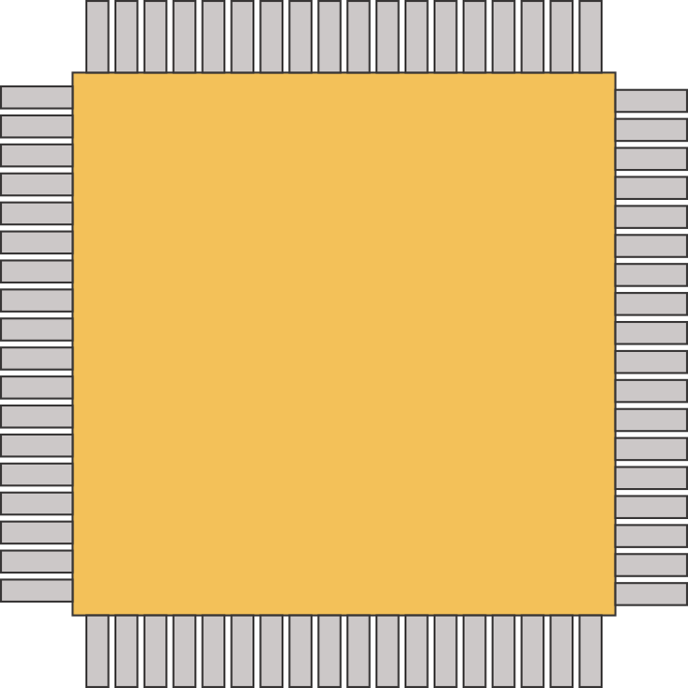
IPLM IP Abstraction Model
Meta-Data
Design Files
Traceability
Usage Tracking
Workspace Tracking
BOI
Engineering
Environment /
Configurations
Tools
Config
Scripts
Extensions
Labels
Properties
Attributes
IP Object
Management
Release Management
IP Versions
Hooks
Design (WIP) IP
Reuse of
Existing Components
Derivative Components
New Components
Integrations
Integration to third party data
Issue & Defect
Requirements
Documents
PDKs &
Libraries
Internal & External IP
“Traditional” IP
Memories
Core
Design Files
Hierarchy
System Metadata
Events
Parent / Child Relationships
Permissions
IP is everything that enables design

Slide 6
This is not only about Data Management…

Slide 7
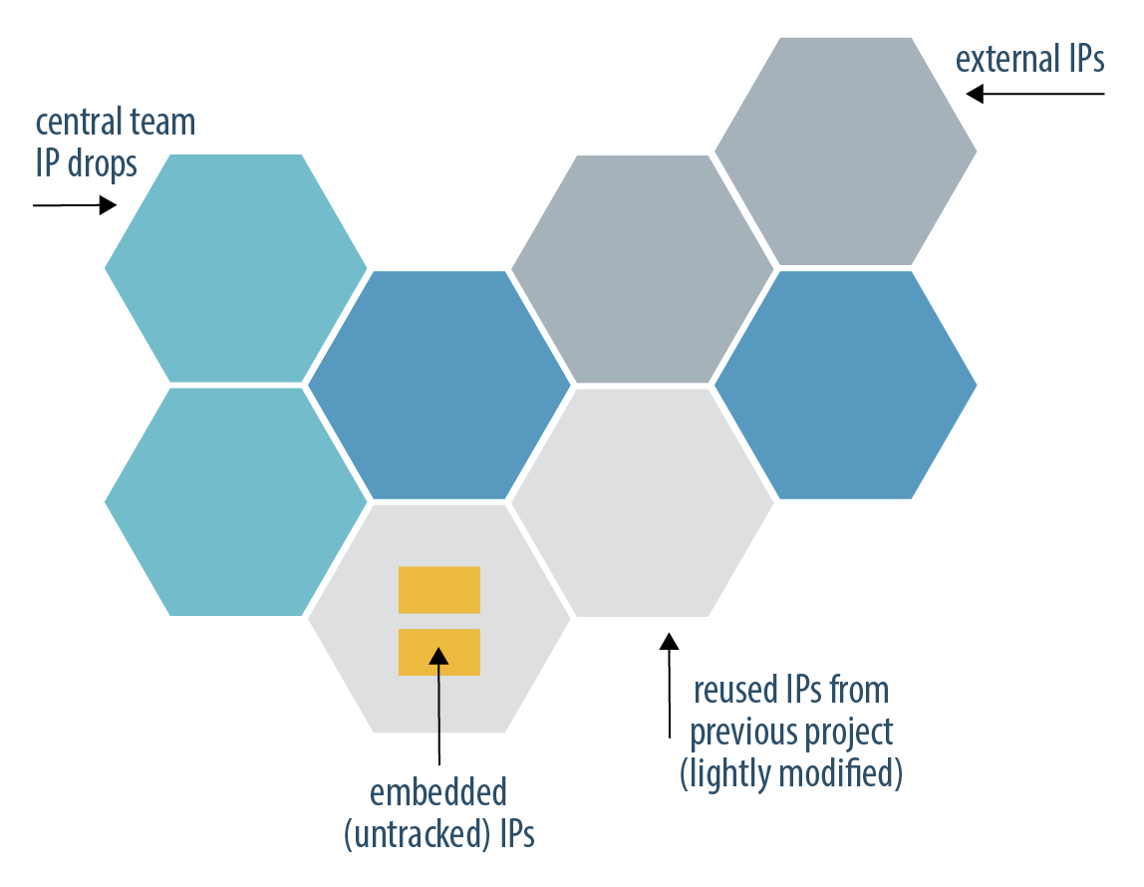
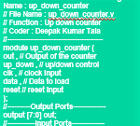
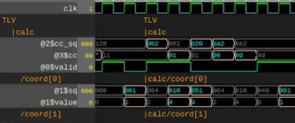
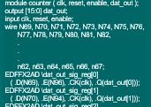
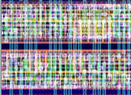
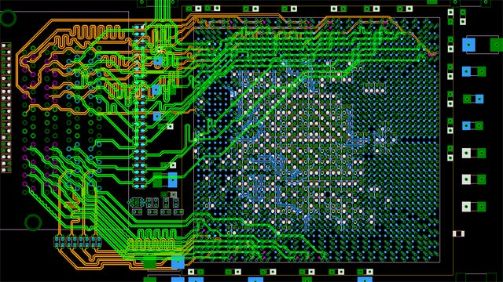
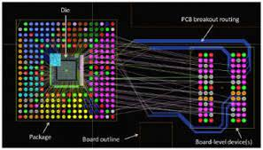
WiP Application Framework
AI /ML
Shift Left Automation
MBCSE
IPLM
EDM
Architecture
RTL | Netlist | Layout
Design | Layout | Simulation
EDA
Tools
EDA
Tools
EDA
Tools
Meta-
Data
Workspace
Management
Workspace
Management
Workspace
Management
Data
Management
GIT
Subversion
Perforce
Custom DM
Teamcenter
EDM Vault
Share

Slide 8
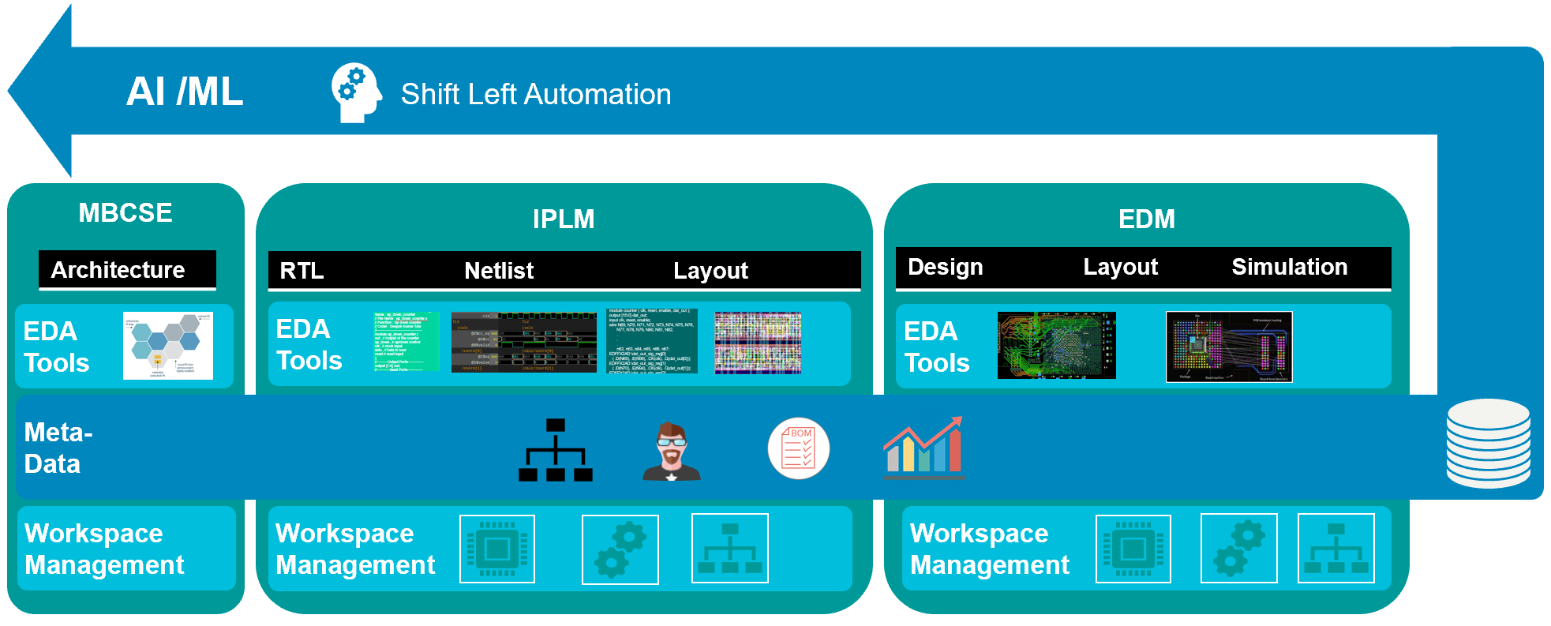
Integrating Semiconductor and Electronics WIP with PLM
Derivatives
PLM
Stagegate Process
Ideation
Program Mgmt
PN: AD620ANZ
Approval
Milestone 1
PN: AD620ANZ
Milestone 2
PN: AD620ANZ
Milestone 3
PN: AD620ANZ
Tapeout
PN: AD620ANZ
Mfg
Sales
Marketing
Support
EOL
Push Project Start
into IPLM flow
+ Project Metadata
Automatically
Push Milestone
BOMs into PLM
Data
Management
GIT
Subversion
Perforce
Custom DM
Teamcenter
EDM Vault
Share

Slide 9
Questions

