Slide 1

Annual Update On Interfaces
Mick Posner
Product Line Group Director
January 25, 2023

Slide 2
Multi-Die System Motivations and Use Cases
Multi-Die Challenges
Die-to-Die standard options
Result of Synopsys user survey
Why UCIe is the standard of choice for multi-die systems

Slide 3
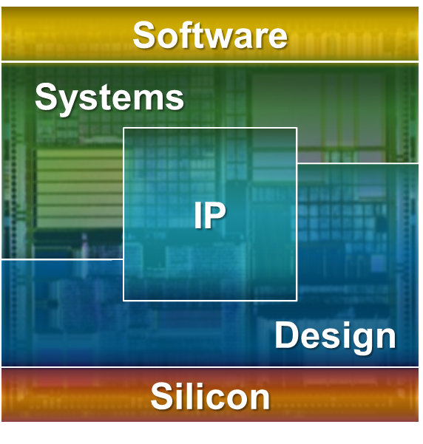
Synopsys Enables System Innovation, Silicon to Software
Comprehensive World-Class Technology
Software:
Application security & quality testing,
Leader in Gartner’s Magic Quadrant
IP:
Broadest portfolio, silicon-proven
#1 in interface, foundation & physical IP
Systems:
Leader in HW/SW verification, virtual prototyping, VIP and models
Silicon:
Reference tools for process optimization, CAD, lithography & yield optimization
Design:
Digital & custom AMS families
Best QoR, highest productivity
Solutions:
Automotive, low power, multi-die, DTCO, memory, SLM, optics, photonic IC
Broadest System Design Coverage
PROCESS
FUNDAMENTALS
DEPLOYED
SYSTEM

Slide 4






Increasing Functionality With More Transistors
Animation 1
Animation 2
Animation 3
Animation 4
Animation 5
Animation 6
Animation 7
Animation 8
Animation 9
Animation 10
Animation 11
Animation 12
For the last 50 years
the semiconductor industry
has been driven by Moore’s Law
2022
Apple A16 Bionic
15B
Transistors
2018
Apple A12 Bionic
6.9B
Transistors
2010
Intel Westmere-EX
2.6B
Transistors
The number of transistors in a dense IC doubles about every two years
2007
Intel XEON 5400
820M
Transistors
2003
IBM PowerPC 970
58M
Transistors
1996
Intel Pentium Deschutes
7.5M
Transistors
Silicon Cost per Yield mm2
250nm
90nm
45nm
32/28nm
7nm
3nm

Slide 5
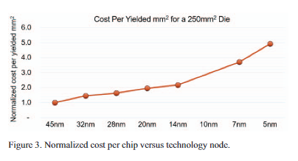
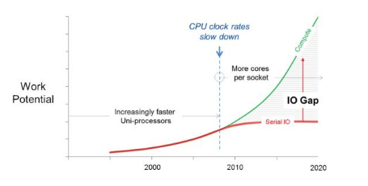

Laws of Semiconductor are Faltering
Moore’s Law
  Cost/mm2 has been increasing since 45-nm
  But … logic density has been ~doubling and power/performance
  increasing by 15% per node
  N3E/N5 Density = 1.5X (typical chip)
Dennard Scaling (1974, Robert Dennard)
  Power Density/mm2 stays constant with doubling of density
  Has been breaking down since late 2000s, limits frequency scaling
  and causes power density challenges
Source: Techsearch, AMD
Amdahl’s Law (1967)
  Increasing system performance by parallelizing CPUs and multi-threading
  But … I/O Speed hasn’t been keeping up with CPU parallelization
  causing system bottlenecks (I/O speeds double every 4 years)
Source: Datacore

Slide 6
Faster Evolution of Protocols
Bandwidth
Bandwidth
Protocol Evolution
Standards accelerating to address IO bandwidth gap
Historically ~ 4 yrs between revisions, but accelerating ~2 yrs
Each requires a new PHY architecture + multiple ports + customizations
Synopsys has the experience and scale to reduce risk and meet aggressive TTM
Bandwidth
Bandwidth

Slide 7
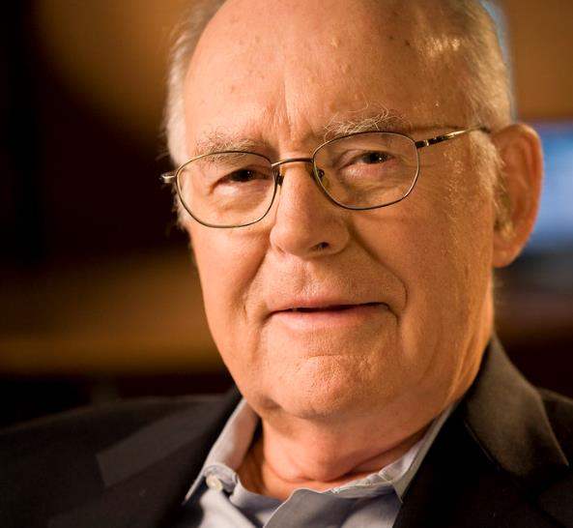
Animation 1
Animation 2
Animation 3
Animation 4
Animation 5
Animation 6
Animation 7
Animation 8
Animation 9
Animation 10
Animation 11
Animation 12
“Day of Reckoning”
Predicted by Gordon Moore
“ It may prove to be more economical
to build large systems out of smaller functions, which are separately packaged and interconnected.”
Courtesy Intel
Source: https://newsroom.intel.com/wp-content/uploads/sites/11/2018/05/
moores-law-electronics.pdf

Slide 8
Multi-Die Systems Accelerating Now
Design Starts Growing 5X in 5 Years
Enabling new levels of functionality and integration for advanced systems
Innovations in packaging drives capabilities
Adopted by multiple market segments today
Significant new challenges for silicon designers abound
Multi-Die System Design Starts
Source: IP Nest 2022

Slide 9

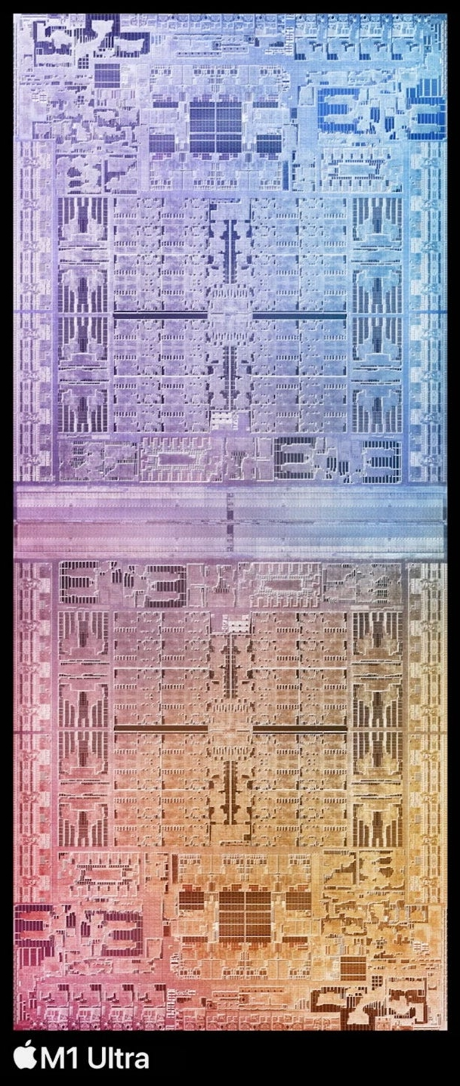
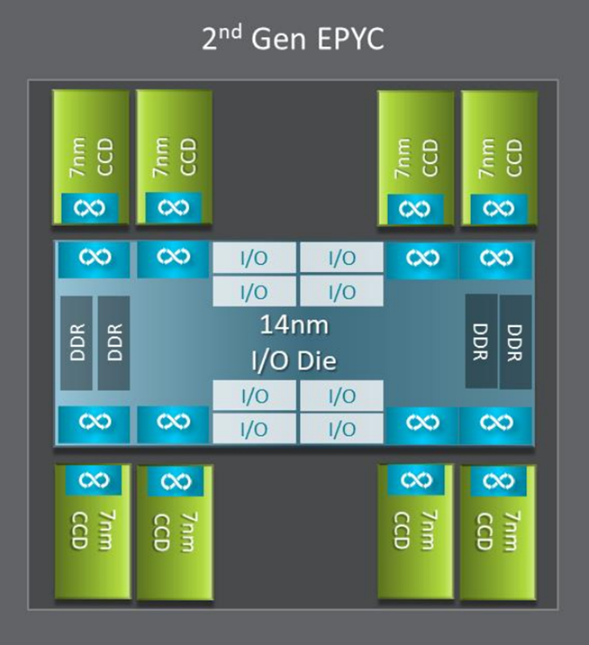
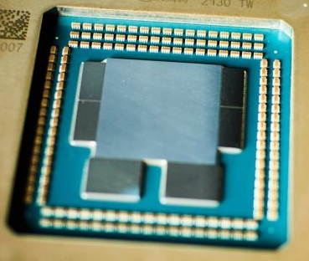
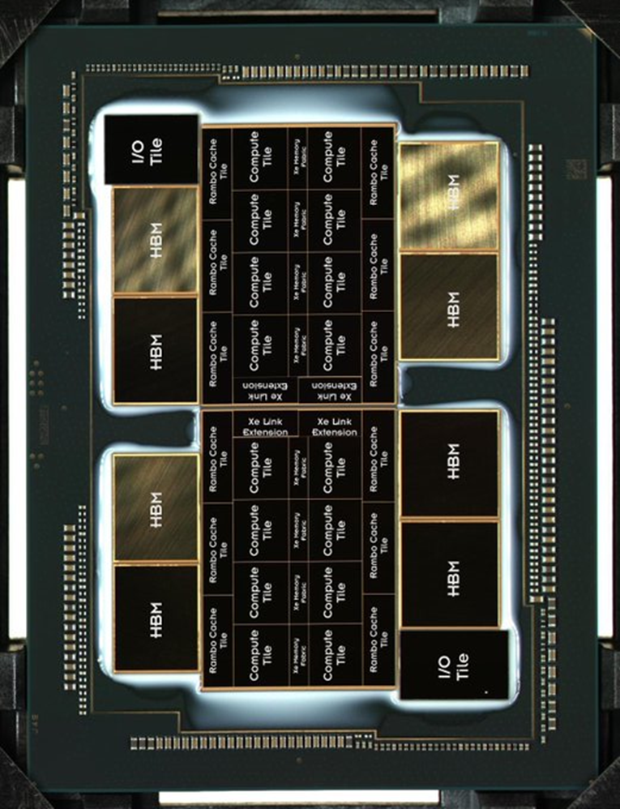
Real World Examples of Multi-Die Systems
AMD
EPYC Server CPU
Apple
M1 UltraMax CPU
Scale & Disaggregate IO
  8 Compute Die +
  1 I/O Die
Substrate Pkg
Scale use case
  2 Compute Die
Silicon Interposer Pkg
Amazon
Graviton3 Server CPU
Intel
Ponte Vecchio Xe-HPC GPU
Disaggregate IO
  1 Compute Die +
  4 DDR Die + 2 I/O Die
Substrate Pkg
Scale & Disaggregate IO
  16 Compute Die +
  8 Cache Die + 2 Base Die
  8 HBM Die + 2 IO Die
EMIB + Foveros Pkg

Slide 10
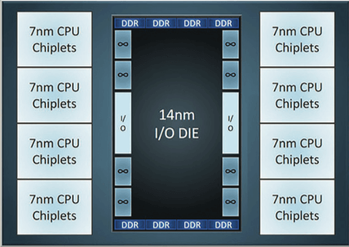
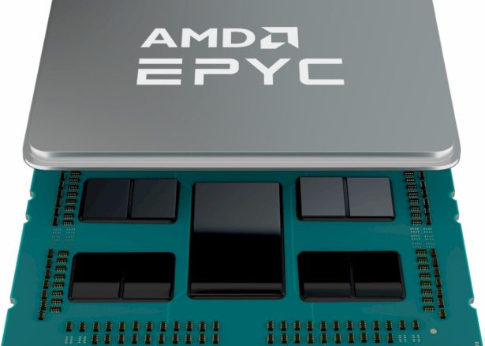
AMD EPYC
8 Compute Dies in 7nm, 1 IO Die in 14nm on Organic Substrate
Proprietary D2D Link – Infiniti Fabric
Resulted in significant lower cost vs. monolithic die
Enabled multiple SKUs for a series of Processors (different CPU / DRAM configurations)

Slide 11
Lower System Cost
Smaller Die with Improved Yield Offsets Higher Silicon Area and Package/Test Cost
Monolithic SoC
Multi-Die System
Hypothetical monolithic 32-core chip compared
to an assembly of four
eight-core chiplets
I/F
I/O
I/F
Memory
CPU Core
Memory
I/F
Memory
Memory
I/F
I/O
I/F
Memory
Memory
I/F
I/O
CPU Core
CPU Core
CPU Core
CPU Core
Memory
Memory
I/O
I/F
I/F
I/O
I/F
I/F
Memory
CPU Core
Memory
772mm² versus 852mm² (+9.7%)
Relative cost = 0.59X
I/F
I/F
I/O
I/F
I/F
I/O
Memory
Memory
CPU Core
CPU Core
CPU Core
CPU Core
I/O
I/F
Memory
Memory
I/F
I/O
I/F
Memory
Memory
I/F
I/F
I/O
I/F
Multi-die systems will become more attractive as
advanced packaging volumes increase & costs decline
Pioneering Chiplet Technology and Design for the
AMD EPYC™ and Ryzen™ Processor Families
AMD 2021 ACM/IEEE 48th Annual International Symposium
on Computer Architecture (ISCA)

Slide 12
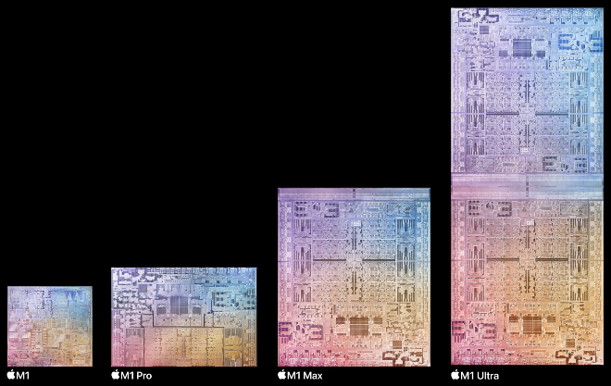
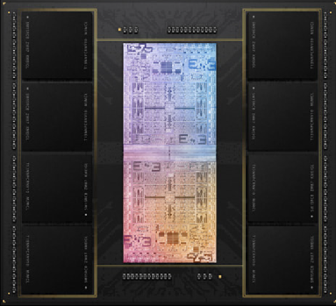
Apple M1 Ultra
2 Compute Dies in 5nm, 8 LPDDR5 Die in an InFO-L Package
Proprietary D2D Link – Ultra Fusion
Power/area efficient Scaling (57B Transistors, 10 CPUs, 64 GPUs) with 2.5TB D2D Bandwidth
Created multiple SKUs – 1 Die for Laptop, 2 Dice for Desktop

Slide 13


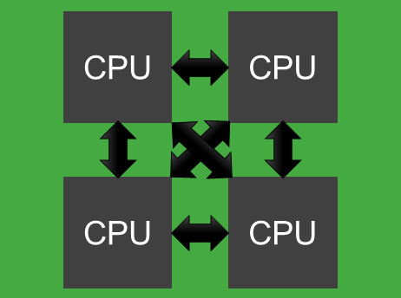
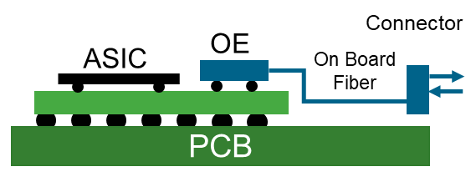

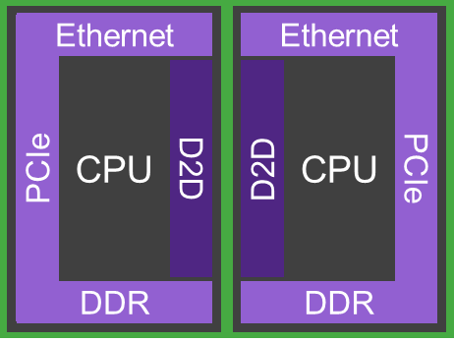
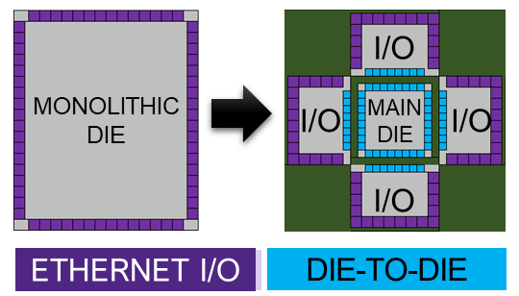
Common Commercial Use Cases
Scaling Processing SoCs
Aggregating Functions
Multiple, scalable clusters of CPUs
Scalable systems, multiple SKUs
Ideal D2D link looks like wire
5-nm → 3-nm
CPU, Accelerators
Aggregate multiple disparate functions
Reduce cost/form Factor
5G Base Station, Co-Packaged Optics
Homogenous Die
Heterogeneous Die
Splitting SoCs
Disaggregating IOs
Large compute & switch dies approaching reticle limit
All about cost/yield (30% less)
Ideal D2D link looks like wire
5-nm → 3-nm
Accelerators, Switch
Split Servers: Processing & I/O Chips
Processor chases Moore’s Law
I/O chip in N-2
Risk, cost, reuse, TTM
CPU, FPGA & Switch

Slide 14
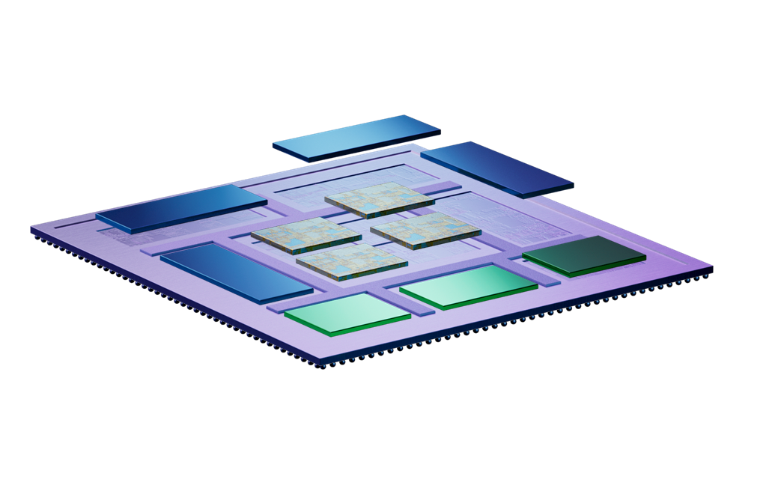
The Drive to Multi-Die Systems
Motivation for Multi-Die Systems
Accelerated scaling of system functionality at a cost-effective price (>2X reticle limits)
Reduced risk & time-to-market by re-using proven designs/die
Lower system power while increasing throughput (up to 30%)
Rapid creation of new product variants for flexible portfolio management

Slide 15
Multi-Die Now, Tracking 100 Design Starts
Customers Don’t Want to Go There … But They Have to go There in Some Applications
By Application

Slide 16
But it’s Not That Easy! Multi-Die System Challenges
Transformation from Monolithic SoC to Multi-Die Systems
Monolithic
SoC
Challenges
Multi-Die
Systems
Heterogeneous
system integration
Power & thermal management
System pathfinding
CPU
Memory
Die-to-die connectivity
Software development & modeling
Capacity/performance for system verification
IO
GPU
System signoff analysis
Hierarchical Test & Repair
Reliability & Security
System yield
Memory utilization & coherency

Slide 17
But it’s Not That Easy! Multi-Die System Challenges
Transformation from Monolithic SoC to Multi-Die Systems
Monolithic
SoC
Challenges
Multi-Die
Systems
Heterogeneous
system integration
Power & thermal management
System pathfinding
CPU
Memory
Die-to-die connectivity
Software development & modeling
Capacity/performance for system verification
IO
GPU
System signoff analysis
Hierarchical Test & Repair
Reliability & Security
System yield
Memory utilization & coherency

Slide 18


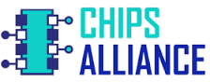

4 Alliances & 5 Standards Across Ecosystem
Technical Merits, Maturity & Strength of Ecosystem are Key for Success
Alliance
Standard | XSR | BOW | OHBI | AIB | UCIe
Data Rate | 112G / 224G | 8G / 16G | 8G / 16G | 6G | 16G / 32G
Protocol | Not Defined | Not Defined | Not Defined | Not Defined | Streaming, PCIe, CXL
Package Focus | 2D | 2D (2.5D also supported) | 2.5D (2D also supported) | 2.5D | 2D, 2.5D
Target Applications | Optical Networking (CPO/NPO) | Cost sensitive aggregation | High density scale for data center | Mil-aero ecosystem | Scale & Split w/ streaming Aggregation w/ PCIe/CXL

Slide 19
Summary of 5 Main D2D Standards
Organic
Substrate
$
Interposer
$$$
Key Figures of Merit: Technical (Bandwidth, Power, Latency) & Cost
0.2
UCIe 8G
UCIe 16G
UCIe 32G
0.4
AIB 6G
OHBI 24G
BOW 8G
OHBI 8G
OHBI 16G
0.6
UCIe 16G
BOW 16G
UCIe 32G
0.8
HIGH Power (pJ/bit) LOW
OHBI 32G
Conclusions Based on Metrics
UCIe offers better metrics at same data rate
Latency similar across OHBI/UCIe, lower than XSR
UCIe 16G PHYs serve HPC for next 3 years
UCIe 32G PHYs for high end AI and next generation networking needed starting in ~2025
1.0
AIB 2G
XSR 224G
1.2
XSR 112G
1.4
1.6
500
1000
1500
2000
2500
3000
3500
4000
4500
5000
5500
6000
6500
7000
7500
8000
8500
9000
9500
10000
LOW Bandwidth per Edge Width (Gbps/mm) HIGH

Slide 20
4 Alliances & 5 3 Standards Across Ecosystem
Technical Merits, Maturity & Strength of Ecosystem are Key for Success
Alliance
Standard | XSR | BOW | OHBI | AIB | UCIe
Data Rate | 112G / 224G | 8G / 16G | 8G / 16G | 6G | 16G / 32G
Protocol | Not Defined | Not Defined | Not Defined | Not Defined | Streaming, PCIe, CXL
Package Focus | 2D | 2D (2.5D also supported) | 2.5D (2D also supported) | 2.5D | 2D, 2.5D
Target Applications | Optical Networking (CPO/NPO) | Cost sensitive aggregation | High density scale for data center | Mil-aero ecosystem | Scale & Split w/ streaming Aggregation w/ PCIe/CXL

Slide 21
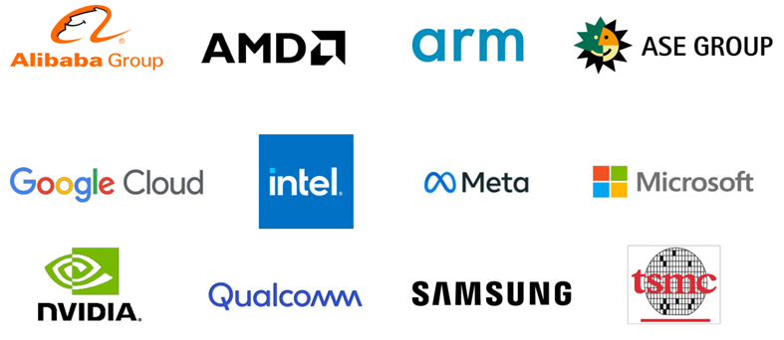
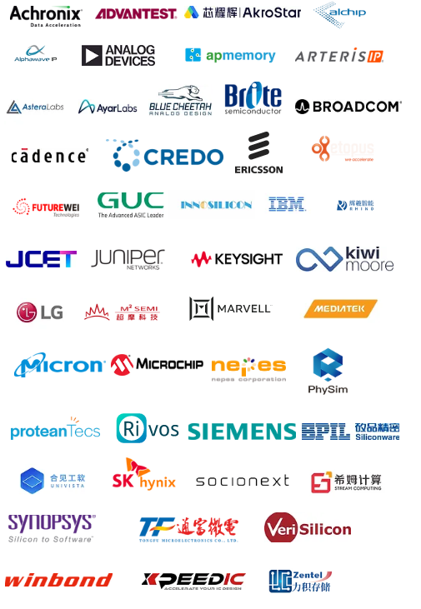
UCIe is the Preferred D2D Interface!
Technical Merits, Comprehensive Spec & Broad Eco-System
Technical Merits (Most compelling PPAs)
  Energy efficiency <0.3pJ/Bit
  Edge efficiency >5Tbps/mm
  Latency ~2ns from Pin to FDI
Comprehensive & Futureproof
  All use cases
  All package types
  Chip to Chip use case with retimer
  Complete protocol stack
  Future proof with support up to 32Gbps data rate per pin
Broad Eco-System
  Wide range of promoters & contributors spanning all industry segments
> 100 members (Dec.2022)

Slide 22
What Standard Do You Plan to Use for D2D Interface?
GLOBAL 2022
Percentages equal >100% because multiple answers were accepted.
2022 N = 210
No historical data as these are new questions starting 2022.
"Don't know" responses are excluded from analysis.
  "Source: Synopsys Global User Survey YEAR(S) – used with Synopsys’ permission."

Slide 23
UCIe Built to Enable Common and New Use Models
UCIe Is Highly Flexible
Server or AI Scaling (Homogeneous)
(NoC-to-NoC with low latency & coherency)
Heterogeneous Computing (Accelerator)
(Interoperability with low latency & coherency)
UCIe Streaming
CXS or AXI bridge
User Defined / Proprietary
UCIe CXL or PCIe
For interoperability
UCIe Streaming
CXS or AXI bridge
Server
Server
Server
Accelerator
IO or Memory Split
(Interoperability with low latency)
Resource Aggregation (Pooling) w/Retimer
(Rack-to-Rack with low latency)
UCIe CXL or PCIe6
Coherency for Memory
UCIe Streaming
AXI bridge for Ethernet
UCIe CXL or PCIe6
For Aggregation
UCIe Streaming
For CPO / Eth.
Memory
Server
Ethernet
Server
SiPh
SiPh
Accelerator

Slide 24
IP Must Support Multiple Package Types
Considerations: Power, Performance, Area, Latency & Cost Trade-Offs
By Package

Slide 25
2.5D Packaging Technologies Evolving for Higher Integration
Summary of Relative Cost & Density Attributes
Interposer
Cost: 1.0x
Pitch: <40μm
IO/mm²: 625
Die 1
Die 2
Fan-out w/Si Bridge
Cost: 0.6x
Pitch: 25μm
IO/mm²: 350
DENSITY
High Density Org Sub
Cost: 0.3 to 0.4x
Pitch: 55μm
IO/mm²: 331
Laminate w/Si Bridge
Cost: 0.4x
Pitch: 55μm
IO/mm²: 331
Fan-out (RDL)
Cost: 0.5x
Pitch: 40μm
IO/mm²: 330
Die 1
Die 2
Die 3
Organic Substrate
Cost: 0.2–0.4x
Pitch: 90μm–110μm
IO/mm²: 83–123
Die 1
Die 2
Die 1
Die 2
Die 1
Die 2
Die 1
Die 2
Source: Jan Vardaman, Tech Search Inc.
COST

Slide 26
Magic Decoder Ring - 2.5D & 3D Technology Names
Leading Manufacturers: TSMC, Samsung, Intel & ASE
 | Technology | TSMC | Samsung | Intel | ASE
2.5D | RDL Fan Out | TSMC InFO-oS/ TSMC InFo-PoP |  |  | ASE FOCoS-CF
 | Bridge | CoWoS_L |  | EMIB | FOCoS-B
 | Interposer | CoWoS_S CoWoS_R | ICUBE H-CUBE R-CUBE |  | FOCoS-CL
3D | Hybrid Bonding | SoIC | X-Cube | Foveros Omni Foveros Direct

Slide 27
IP Required By Package & Across Nodes
Need To Support Multiple Technology Nodes Across Multiple Foundries & Packages
By Package
By Node

Slide 28
Synopsys UCIe IP Leverages Generations of D2D & HBM IP
Track Record with Multi-Die System PHY Products
HBI+
4Gbps
TSMC 7nm
2.5D (I+B)
HBI+
4Gbps
GF 12nm
2.5D (I)
OpenHBI
16Gbps
TSMC 3nm 2.5D (I)
UCIe
16Gbps
TSMC 3/5/7nm
2.5D (I+B)
2D (S)
Prioritize UCIe
HBI
2Gbps
Sams 14nm
2.5D (I)
90% complete
Not Taped-out
Production
HBI+
4Gbps
TSMC 5nm
2.5D (I)
AIB2.0
4Gbps
Intel 16nm
2.5D (B)
Production
Production
Tapeout
XSR
112Gbps
TSMC 7nm
2D (S+I)
XSR
112Gbps
TSMC 12nm
2D (S)
XSR
112Gbps
GF 12nm
2D (S)
XSR
112Gbps
TSMC 6nm
2D (S)
XSR
112Gbps
TSMC 5nm
2D (S)
Extensive Packaging
Expertise
Production
Production
Silicon Proof
Silicon Proof
In Lab
HBM2e
3.6Gbps
TSMC 7nm
2.5D (B)
HBM3
6.4Gbps
TSMC 6nm
2.5D (I)
HBM3
7.2Gbps
TSMC 5nm
2.5D (I)
HBM3
9.6Gbps
TSMC 3nm
2.5D (I)
Several Products, TSMC 7nm, 6nm, 5nm
Production
Package type: 2.5D: I – Interposer, B – Bridge / 2D: S – Substrate
Production
Tapeout
D2D (AIB/HBI & XSR) and HBM IP in production with several customers using Interposer and Bridge packaging

Slide 29



Robust and Secure IP for Multi-Die Systems
Synopsys UCIe Die-to-Die IP: Complete Solution Based on Silicon-Proven Technology
Multi-Die System
Controller
UCIe Controller IP
Low latency bridge for NoCs in a multi-die system
Optional security engine with encryption
Interface Bridge (CXS/AXI)
Protocol Layer (CXL/PCIe)
D2D Adapter
Security
UCIe PHY IP
Low latency & power for interposer & substrate designs
Extensive test & debug features for KGD
PHY
Test & Diagnostics
Verification IP
SiPi
UCIe Verification IP
Scalable architecture to support verification of various DUT types
Build-in protocol checks and functional coverages at all layers
Subsystems
Advanced/Standard Packages

Slide 30
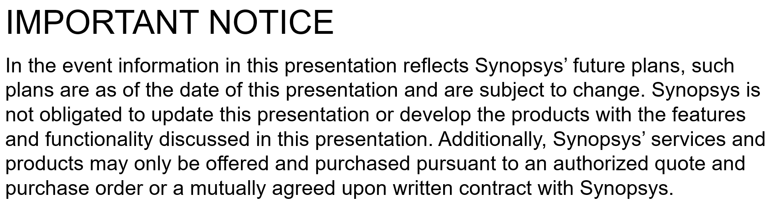
Synopsys UCIe Solution Summary
Wide Process Coverage to Enable Expanding Multi-Die System Ecosystem
Process Node | UCIe PHY
 | UCIe-A | UCIe-S
TSMC N3P | n | n
TSMC N3E | n | n
TSMC N4P | n | n
TSMC N5 | n | n
TSMC N6/7 | n | n
TSMC 12/16FFC |  | n
Samsung 3GAP | n | n
Samsung 4LPP | n | n
Samsung 5LPe | n | n
Intel | n | n
Global Foundries | n | n
UCIe Controller
Base (Stream) | CXS.B Bridge | AXI Bridge | CXL | PCIe
n | n | n | n | n
■ In Planning
■ Committed Timelines
UCIe-A = Advanced Packaging
UCIe-S = Standard Packaging
Contact Synopsys for existing XSR IP Solution, Controller & PHY, Availability

Slide 31
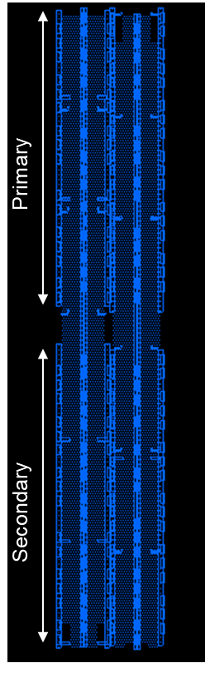
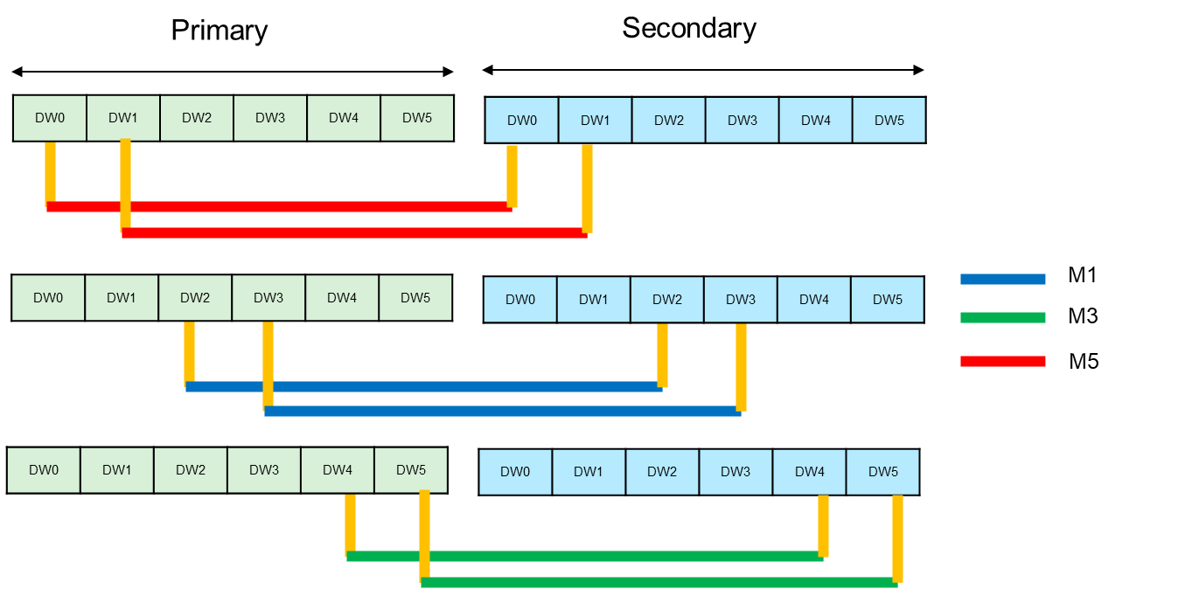
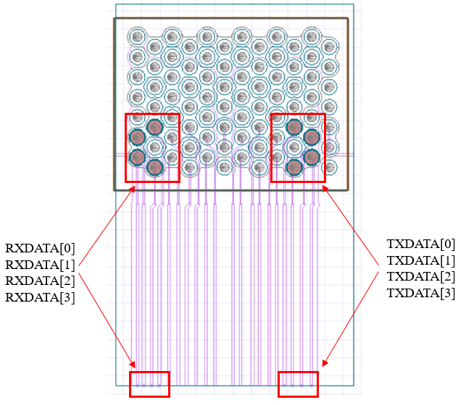
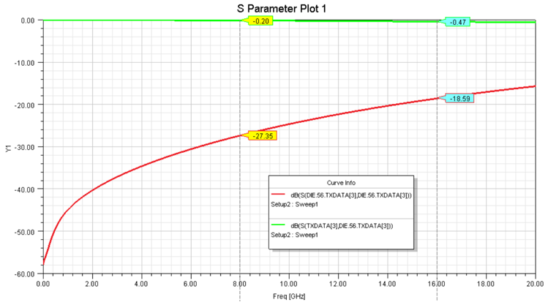
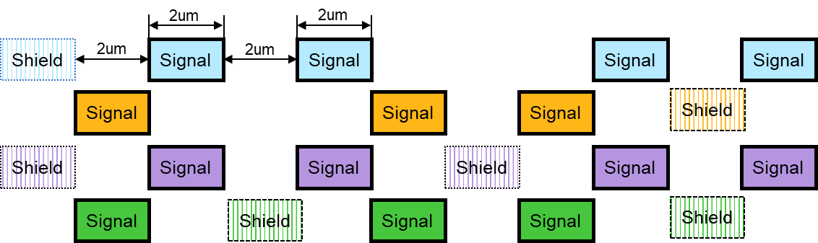
Expanded Design Support for UCIe
With Synopsys 3DIC Compiler and Package / SIPI Analysis
Advanced Package Design
SI PI Analysis
3DIC Compiler Reference designs, training & application notes
UCIe-Route – Auto-routing & PPA intelligence built into Synopsys’ 3DIC Compiler
Escape studies, Std. & Adv. Packages
Floorplan analysis for UCIe multi-module configs
Package characteristics alignment with UCIe variants
CoWoS Pattern Study
Substrate Escape Study
Insertion Loss [dB]
Return Loss [dB]

Slide 32
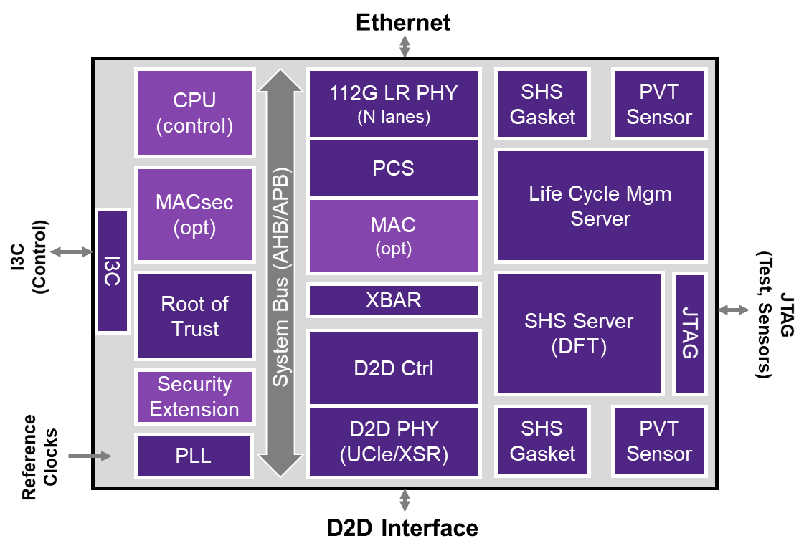
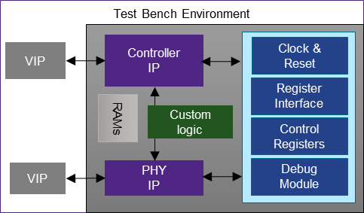
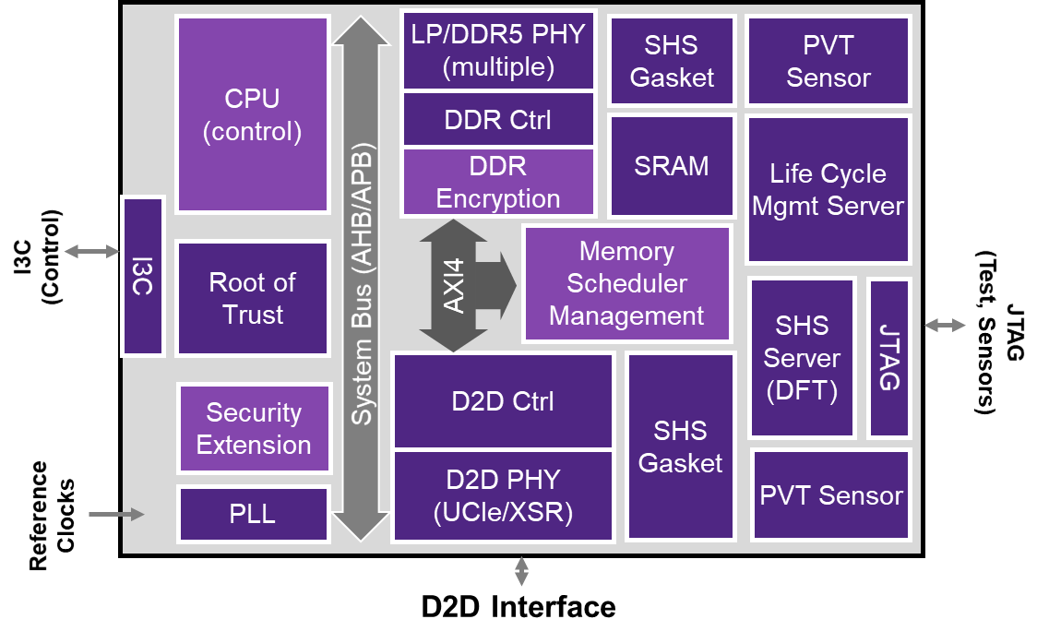
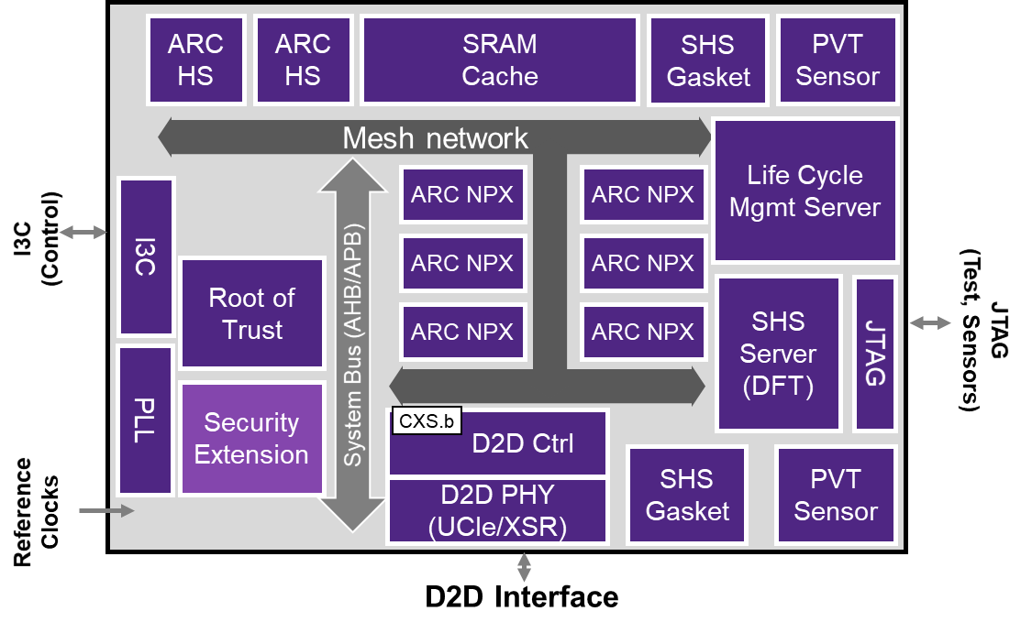
Synopsys IP Chiplets for Multi-Die Systems
SYNOPSYS IP CHIPLETS
Built on Synopsys’
silicon-proven,
high-quality IP portfolio
Flexibility to support multiple package types
Customizable to target application
Key features
  Standards-compliant Die-to-Die interfaces
  Hierarchical test
  Built-in security
  Silicon lifecycle management
  Yield enhancement functionality to save system cost
Integrated & ready
for tapeout for fast
time-to-market
IP CHIPLETS
Ethernet IO Chiplet
IP SUBSYSTEMS
Configured Interfaces
(ie, PCIe Subsystem)
BROAD IP PORTFOLIO
Foundation IP
Memory Expander Chiplet
Interface IP
Security IP
Processor IP
Silicon proven
High quality
Secure
AI Accelerator Chiplet
Pre-validated
Integration-ready
…

Slide 33

Synopsys IP Portfolio
SYNOPSYS IP PORTFOLIO
Broadest Portfolio
Foundation IP, Analog,
Interfaces, Security,
Processors, Subsystems
Software
CPUs
MPUs
DDR/HBM
PHY
PCIe
PHY
HDMI/DP
PHY
USB
PHY
10/56/112G
PHY
UCIe/XSR
PHY
C/D-PHY
M-PHY
Safety
Security
DDR/HBM
controller
PCIe
controller
HDMI/DP
controller
USB
controller
Ethernet
controller
Die-to-Die
controller
CSI
DSI
UFS
UniPro
Highly Differentiated
Delivering IP at the Cutting Edge of Technology & Functionality Across Key Markets
AMBA 4 AXI, AMBA 3 AXI & AMBA 2.0 AHB
DSPs
AI & ML
Processor
IP
Subystems
Embedded Memories
(TCAM, SRAM, ROM, NVM)
GPIOs,
LVDS
PVT
Sensors
SD/eMMC
controller
BLE 5 Link
Layer
ADCs
DACs
eMMC
PHY
BLE
Radio
Committed to Your Success
5,800+ IP Engineers Worldwide Dedicated to Quality
Datapath, incl. Floating Point Elements
Logic Libraries
ARC Processor IP
Digital IP
Physical IP

Slide 34
Synopsys Multi-Die System Solutions
A Comprehensive Solution for Heterogeneous Integration
Architectural Exploration
Optimize thermal, power,
and performance with early exploration and partitioning
Architectural Exploration
Multi-Die/Package
Co-Design
Software Dev. & Validation
Thermal/
Power Analysis
SW Dev. &
System Validation
Rapid software development
and validation with high-capacity emulation & prototyping
Verification
Silicon IP
Design Implementation
Efficient die/package co-design with unified exploration-to-signoff platform and robust IP
IP Chiplets
Test & Repair
Manufacturing
& Reliability
System Signoff
Silicon Lifecycle Management
Improve health, security and reliability with holistic test and lifecycle management solutions

Slide 35

Multi-Die Systems: The Next Wave of System Design
Synopsys is Your Partner for Successful Multi-Die Systems
Initial markets: HPC/Server, AI accelerators, automotive, and mobile--and expanding
Significant system benefits
  Reduced cost, increased functionality, reduced schedules, increased flexibility
Significant challenges to navigate
  Security, standard interfaces, power and thermal management,
  predictive analysis for reliability
Synopsys is your preferred EDA and IP partner for multi-die systems
  Architectural exploration to optimize thermal, power, performance
  Software development and system validation
  Design implementation from exploration to signoff
  Robust & secure die-to-die IP
  Manufacturing & reliability with hierarchical test, diagnostics and repair
  Silicon Lifecycle Management from die to fleet of multi-die systems

