Slide 1
The CHIPS Act
How we got here and why we need to
build a robust chiplet ecosystem
Daniel Armbrust
Chiplet Summit, San Jose CA
– Jan 25, 2023 –

Slide 2
The CHIPS Act
How we got here and why we need to
build a robust chiplet ecosystem
Remarks today are made in his personal capacity, and his remarks should not be attributed to the Department of Commerce, the Industrial Advisory Committee of the CHIPS Act, or the US Government.

Slide 3
CHIPS Act – generational opportunity
How we got here?
What matters for our future?
Why did we need the CHIPS Act?
How do we build a robust chiplet ecosystem?

Slide 4
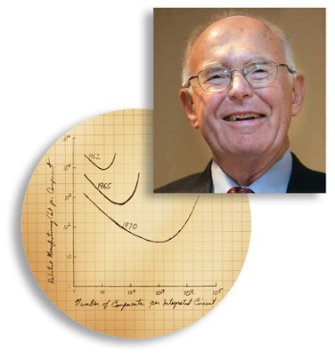
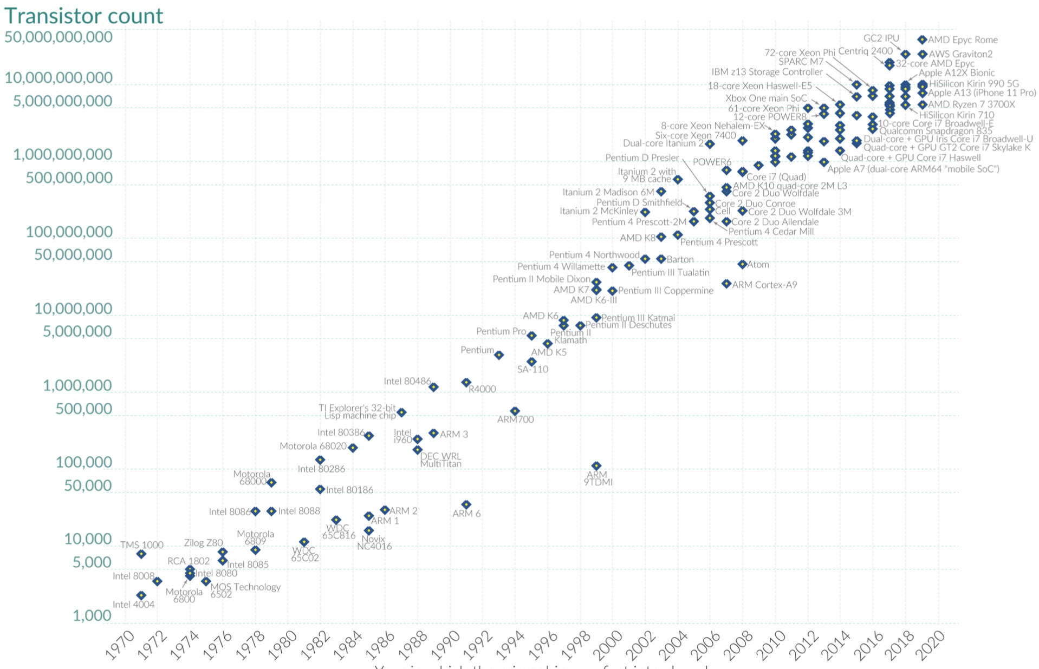
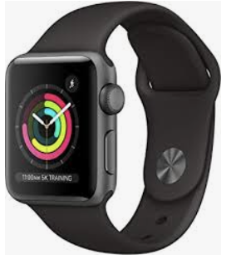

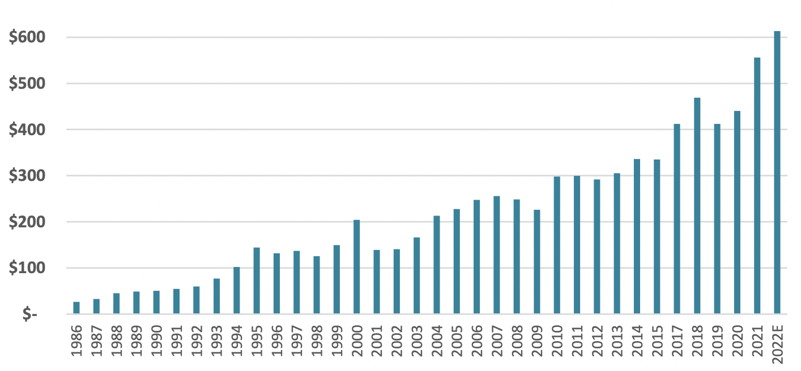
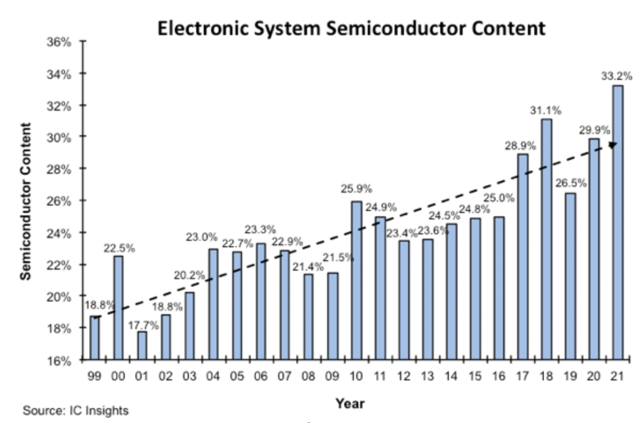


Moore’s Law economic-based prediction
Transistors on a Chip
More R&D
(innovation)
Lower
cost/function
$’s
Source: Wikipedia
Increasing
semiconductor
revenue
Expanding
applications
(more silicon)
Semiconductor Revenue
Source: WSTS

Slide 5

















From U.S. startups and venture capital to geographic dispersion and consolidation
Country Market share (IC Insights)
US
54%
EU
6%
Taiwan
22%
Japan
6%
Korea
9%
China
5%
1960’s 2020’s

Slide 6
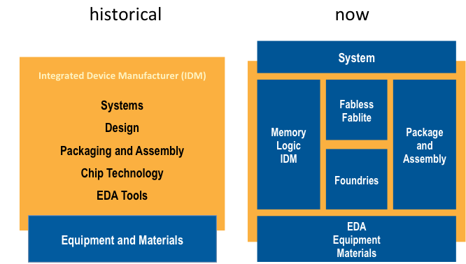
Evolution of the supply chain and it’s fragmentation

Slide 7
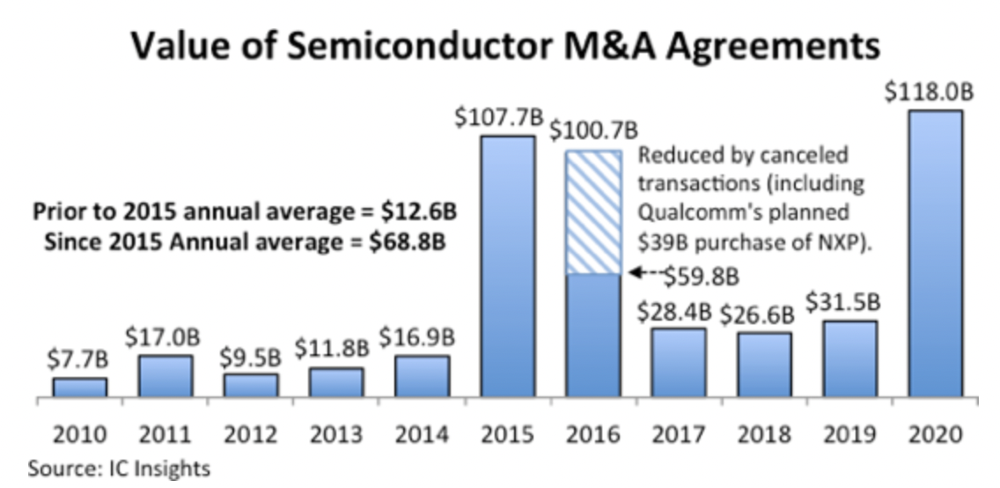
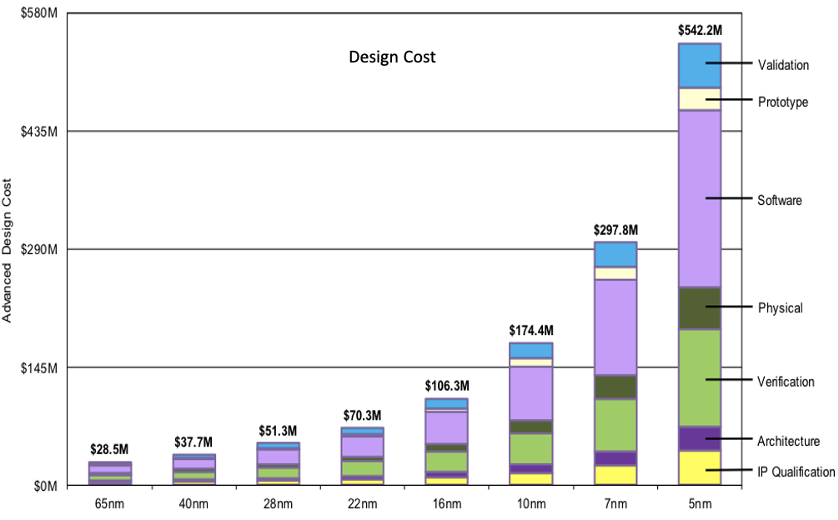
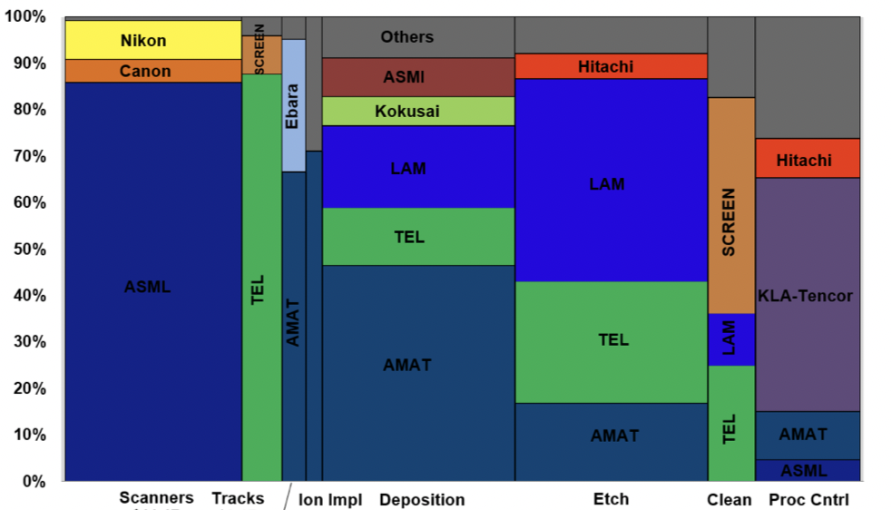
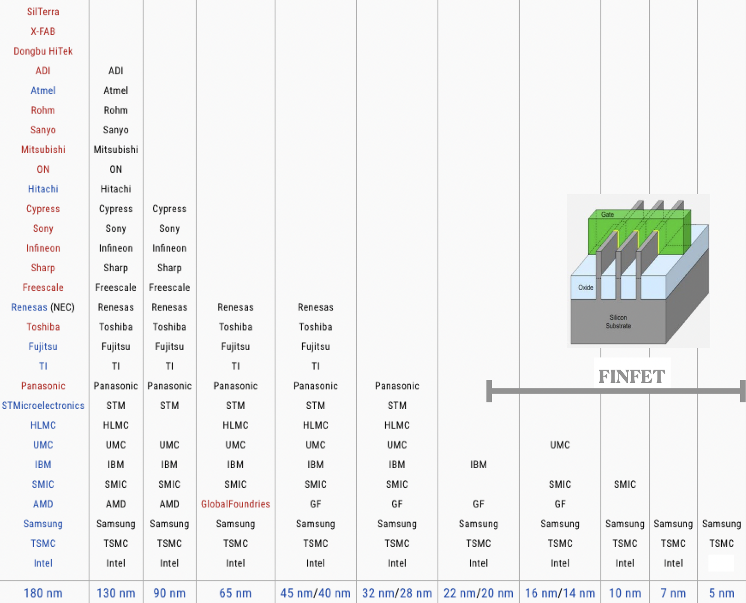
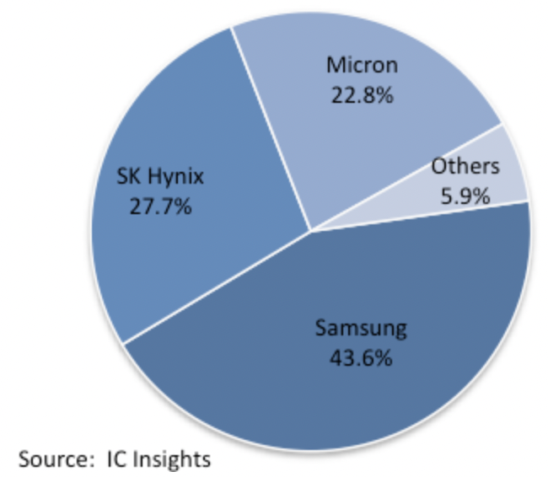
Consolidation and concentration in each segment
Semiconductor M&A Valuation
Chip design costs
$22.7B $20.6B
2021 2022
Source: IC Insights
Source: M. Lapadeus, Semi Eng.
Equipment Market Share
Logic/Foundry platforms
DRAM Market Share
Source: VLSI Research, 2020
Source: Wikipedia
Source: IC Insights

Slide 8
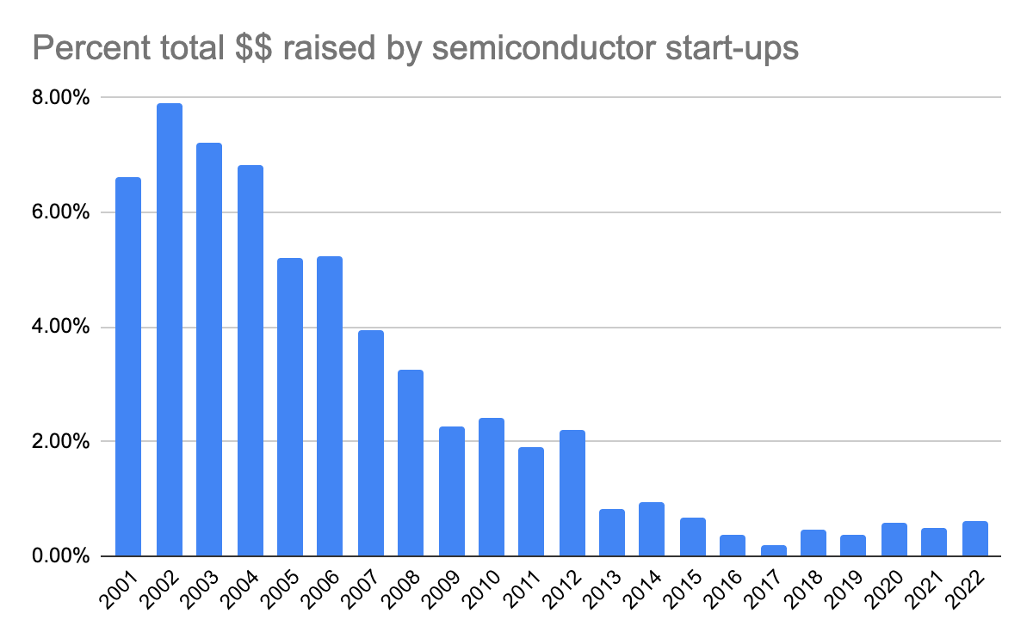
Venture Capital in semiconductors
VC investment in semiconductor startups as % of total VC funding
8%
6%
4%
2%
0%
Source: Pear Ventures & Crunchbase

Slide 9
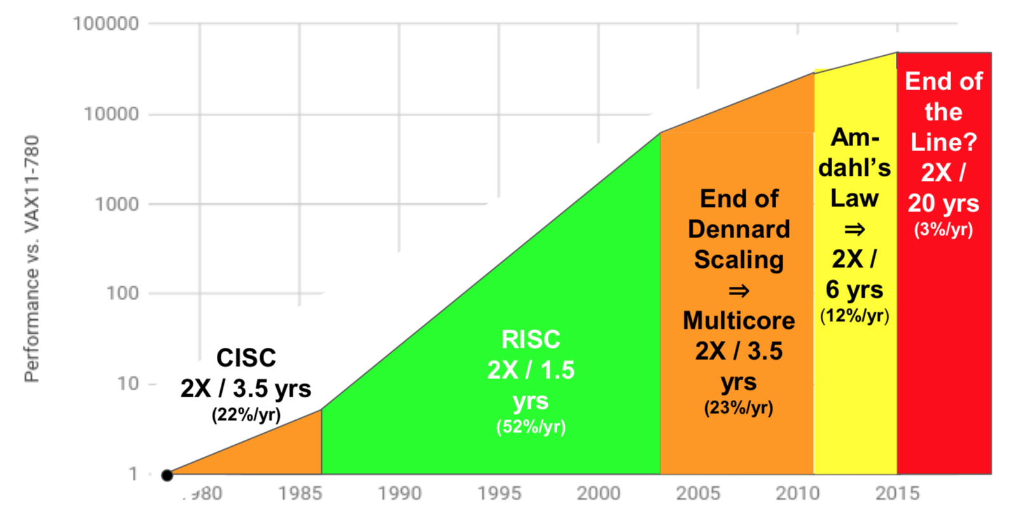
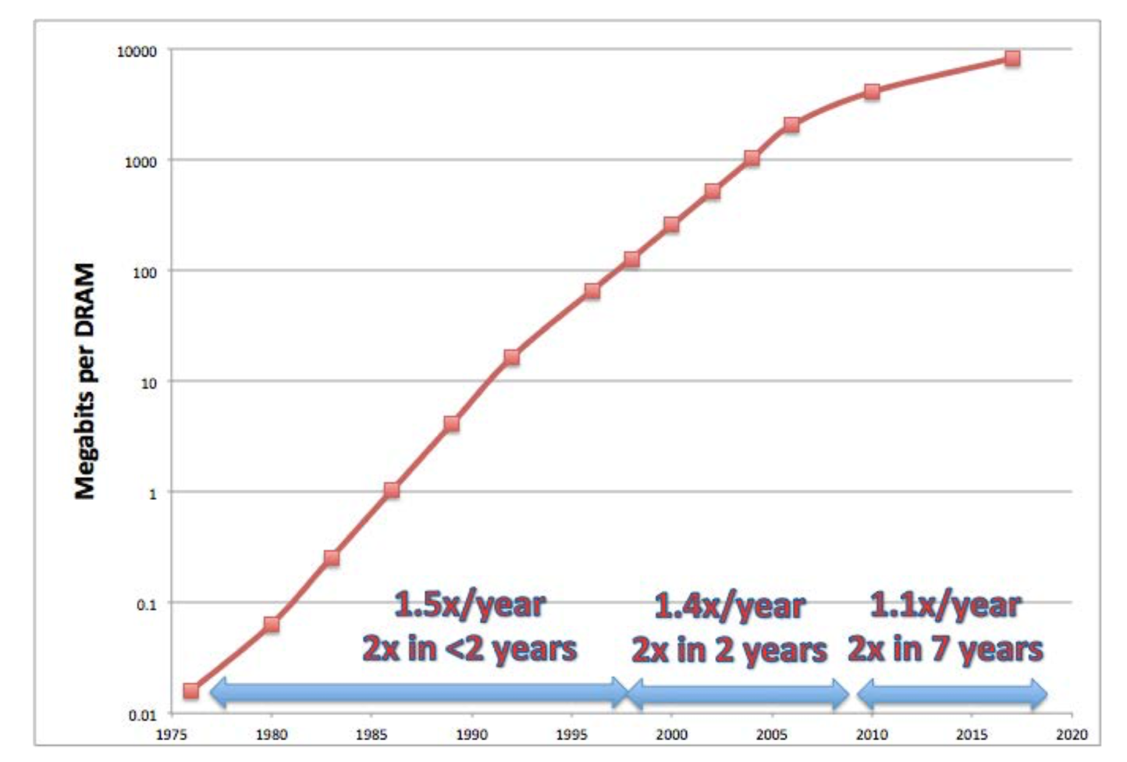
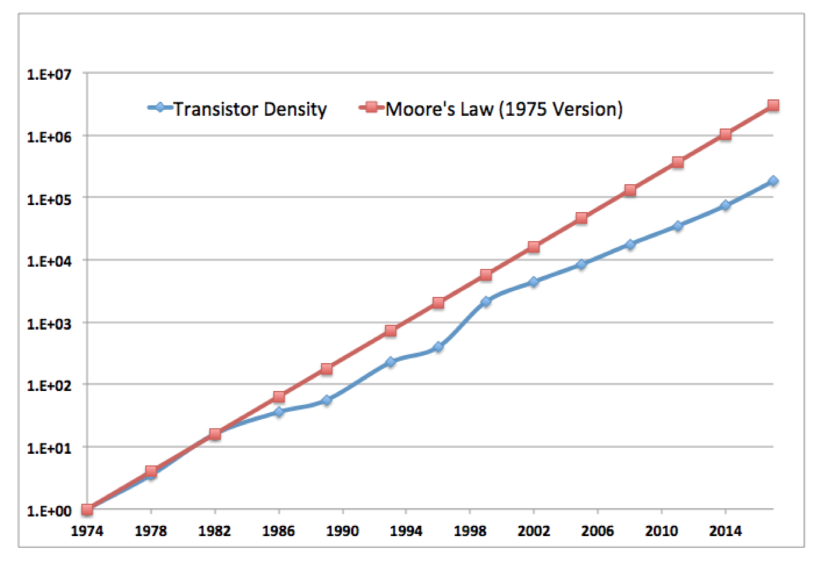
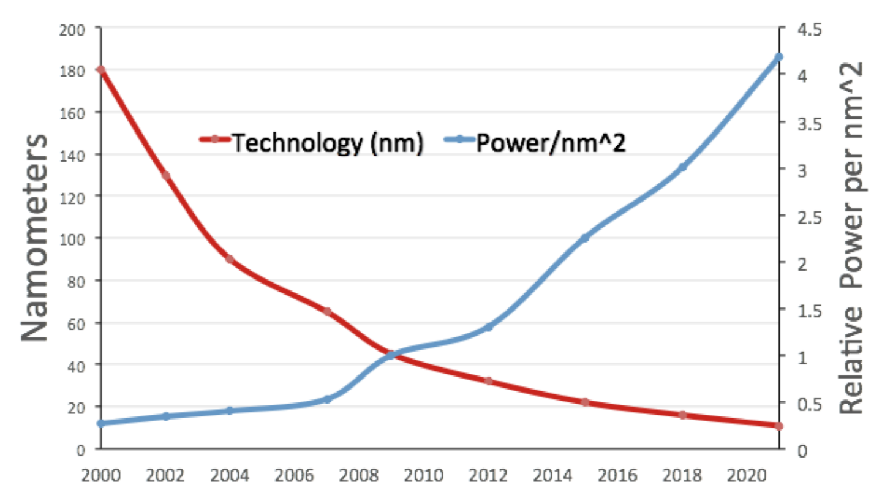
Evidence of Moore’s Law slowdown – Scaling is in a crisis
CPU single core performance
DRAM density roll off
Intel CPU density roll off
Transistor power takes off
Source: Hennessy/Patterson Turing Award presentation

Slide 10


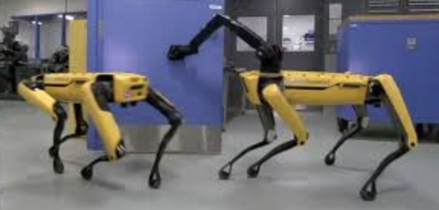
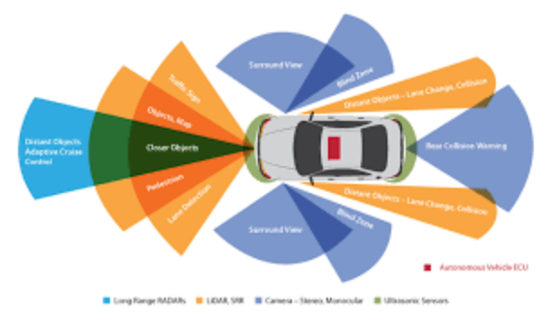
3 6
The memory wall: emerging applications at least 10 – 10 performance gap
Virtual / Augmented Reality
A.I. / Machine Learning
Remote Intelligence
Autonomous Vehicles

Slide 11
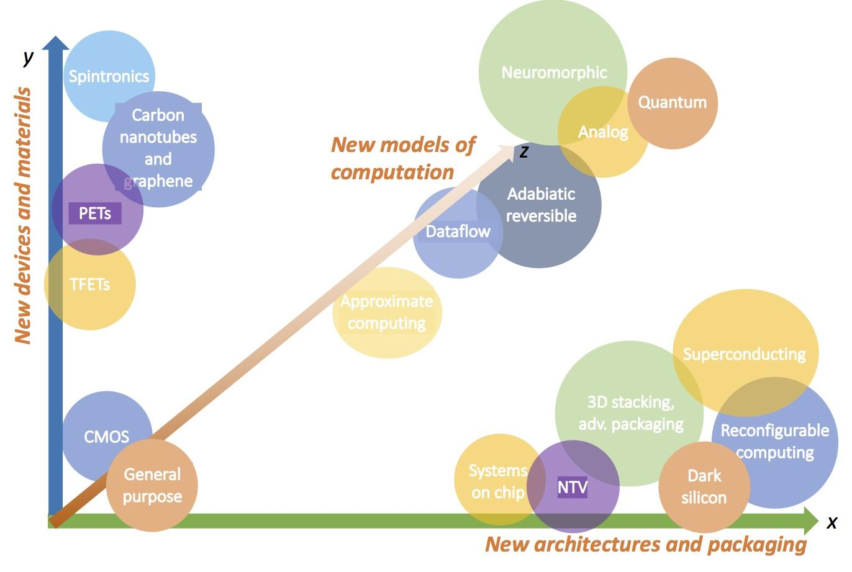
Many unproven candidates yet to be invested at scale
New Materials and Devices
20+ years (10 year lead time)
More Efficient Architectures and Packaging
The next 10 years
Notes:
Note: need to work on the

Slide 12
Forces shaping future industry evolution
System firms become silicon houses
Domain specific architectures
Intel’s entry into foundry
China
Chiplets and heterogeneous packaging
CHIPS Act
Future
?

Slide 13










System companies becoming silicon houses
 | Apple | Google | Amazon | Microsoft | Meta | Baidu | Cisco | Huawei | Samsung | IBM
System
Chip Design limited
Chip Design extensive
Chip Mfg
Source: VLSI Research (modified)

Slide 14
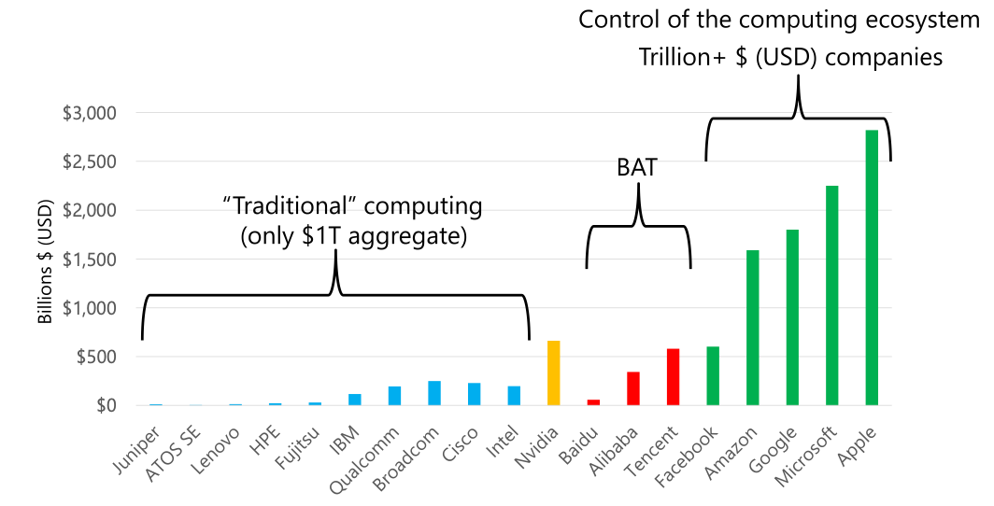
Economic context for cloud systems vs silicon/traditional compute houses
Source: Dan Reed, 2022

Slide 15
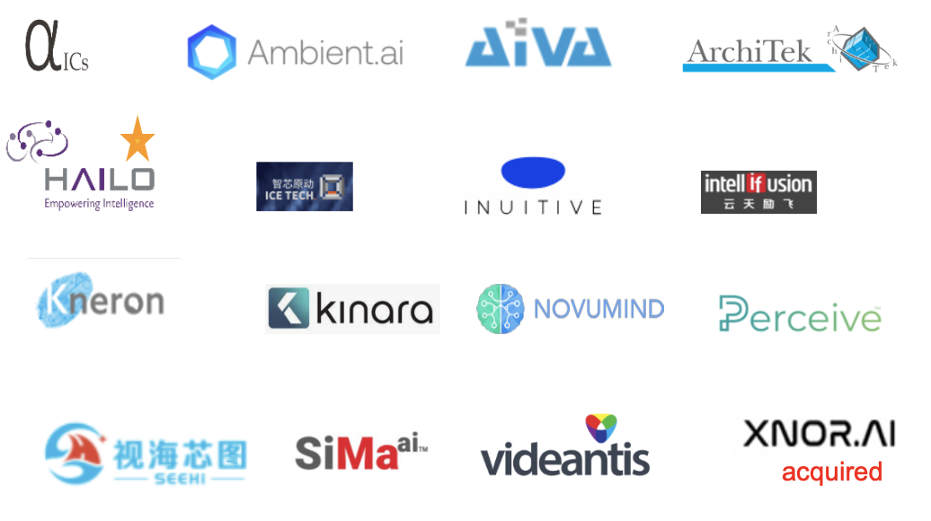
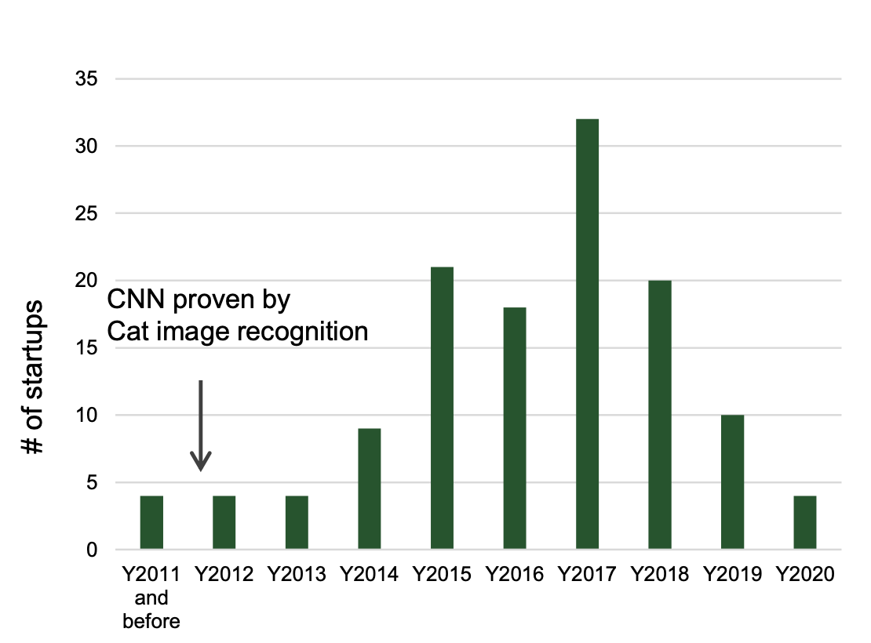
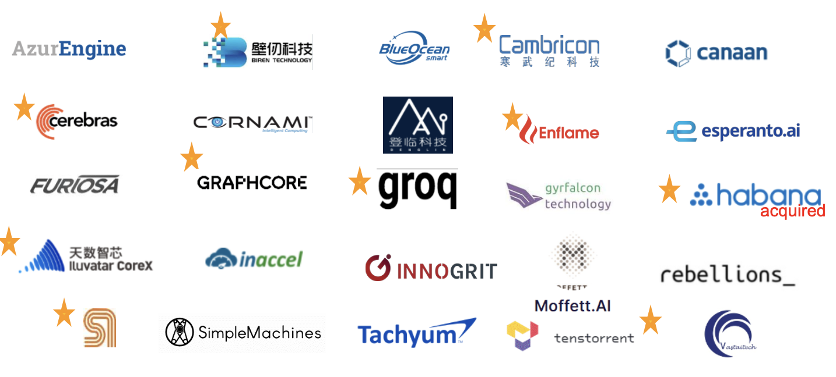
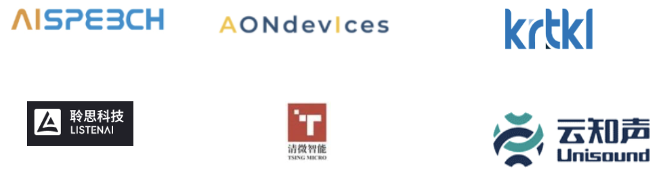

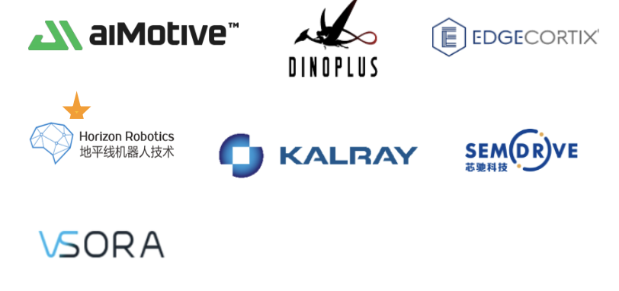
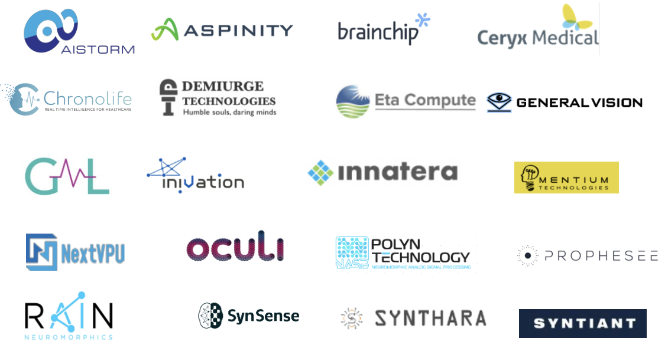

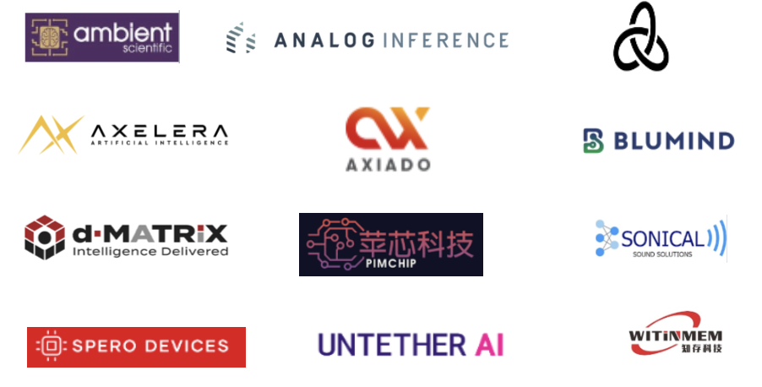


Domain specific accelerators / architectures
Edge
Cloud
AI/ML startups formation
Von Neumann
Neuromorphic
Non-Von Neumann
In-Memory
Optical / Photonics
Source: Woodside Capital Partners

Slide 16
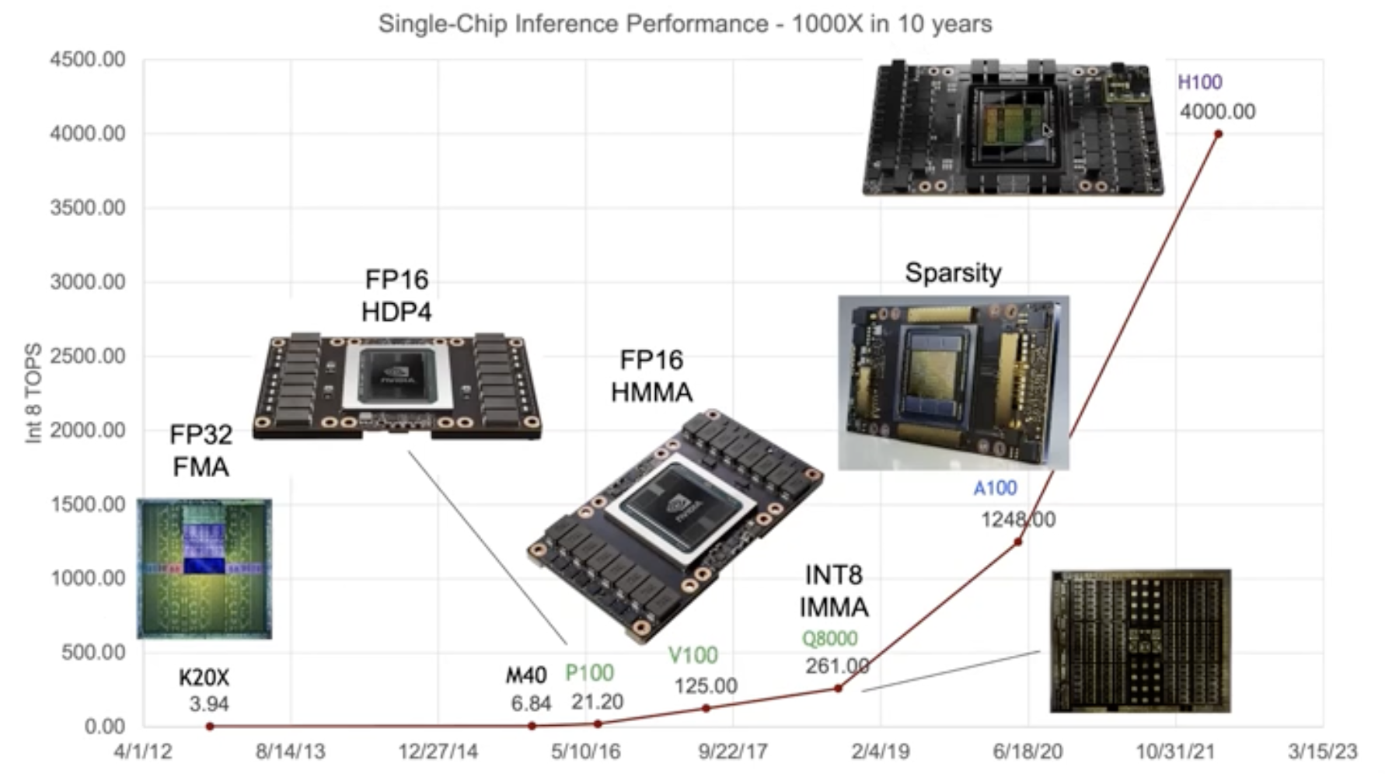
Acceleration of AI with GPUs
Source: Nvidia

Slide 17
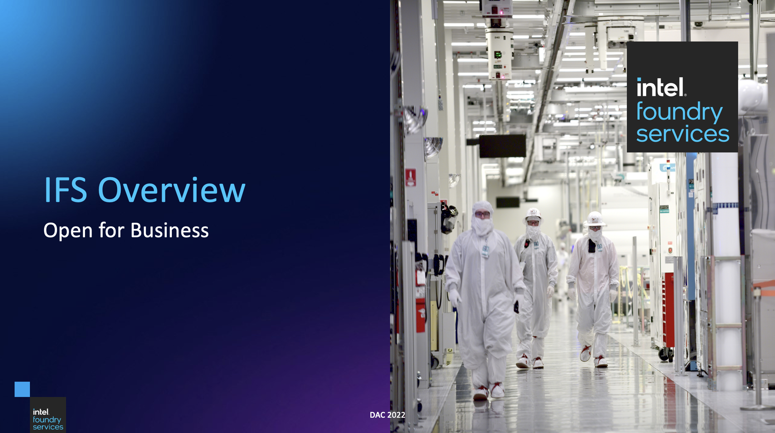
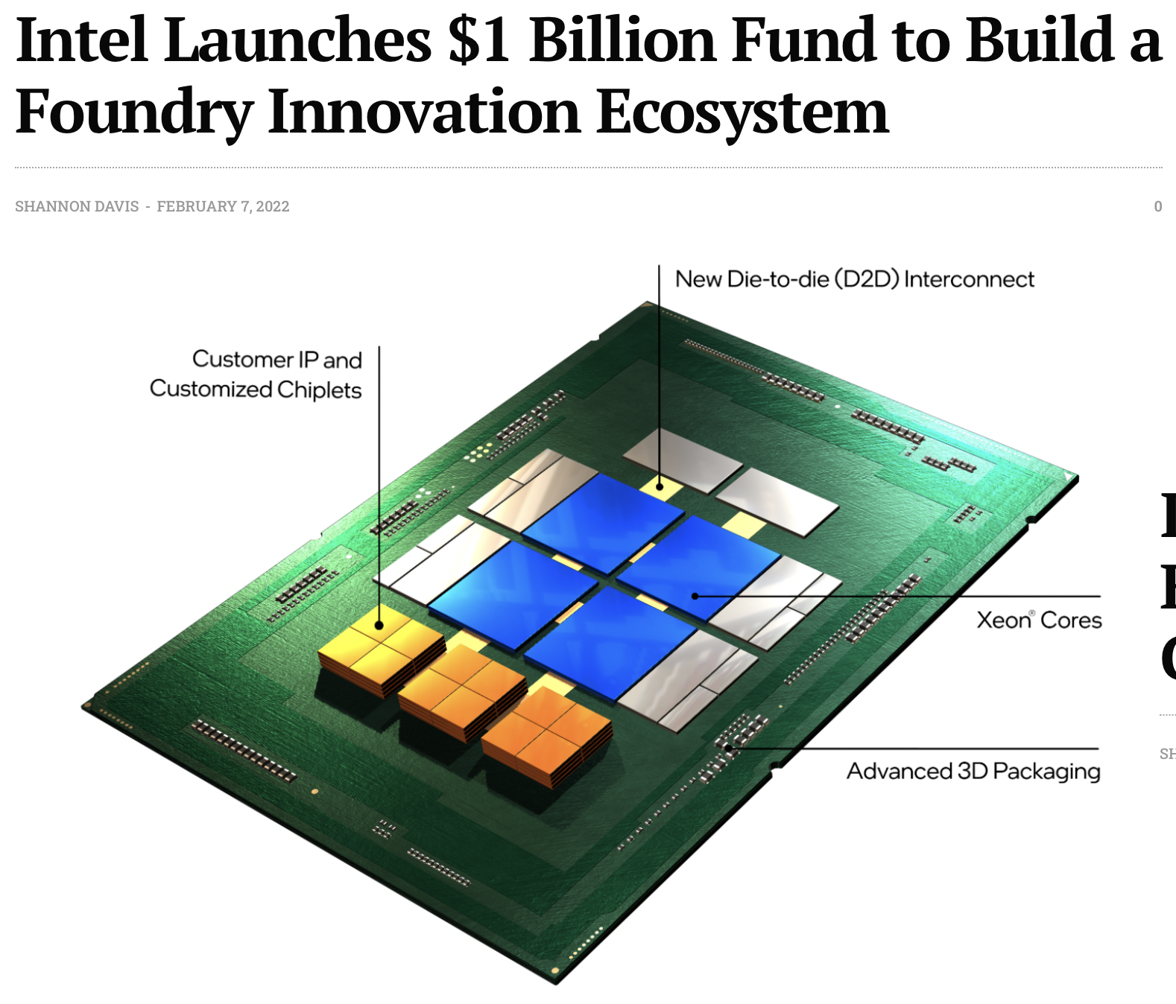
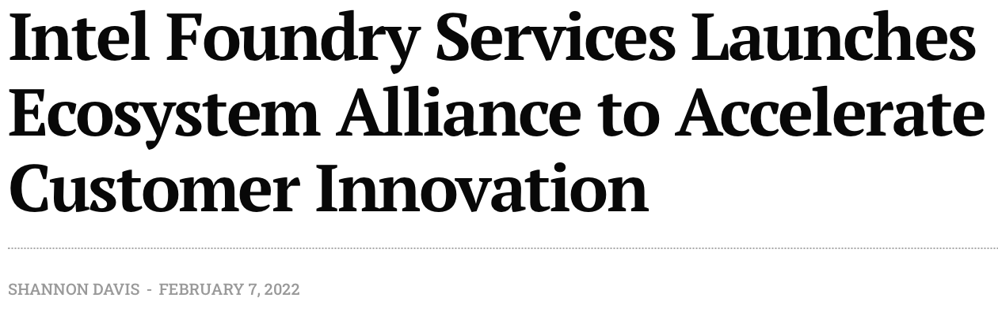
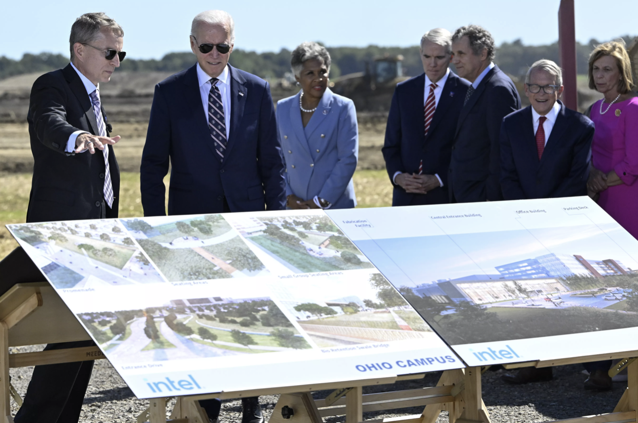


Intel’s entry into foundry
President Biden attends Ohio Groundbreaking
Source: Semiconductor Digest / Getty Images

Slide 18
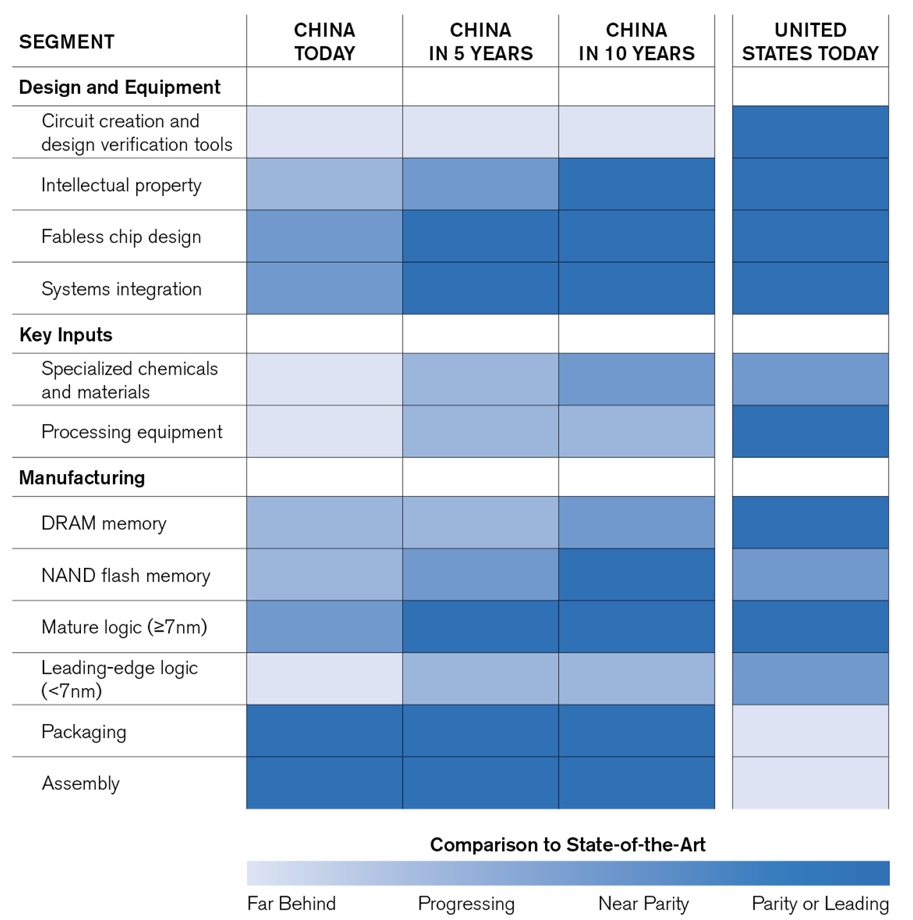
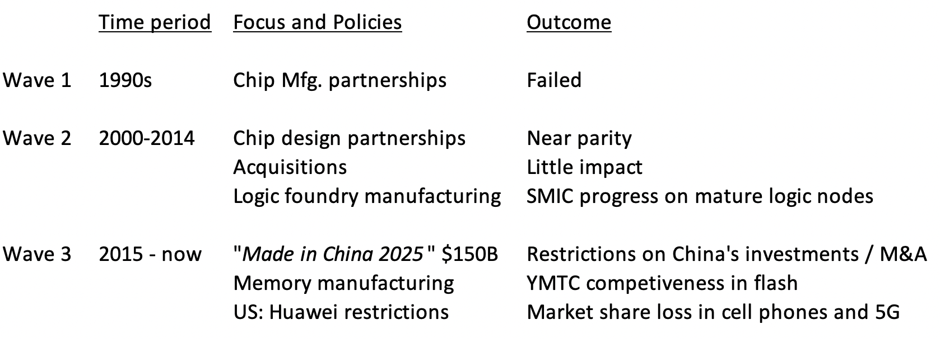
China’s competitiveness in semiconductors
China’s Relative Competitiveness
China’s 3 Investment Waves
Source: Armbrust, Thompson and Evans

Slide 19
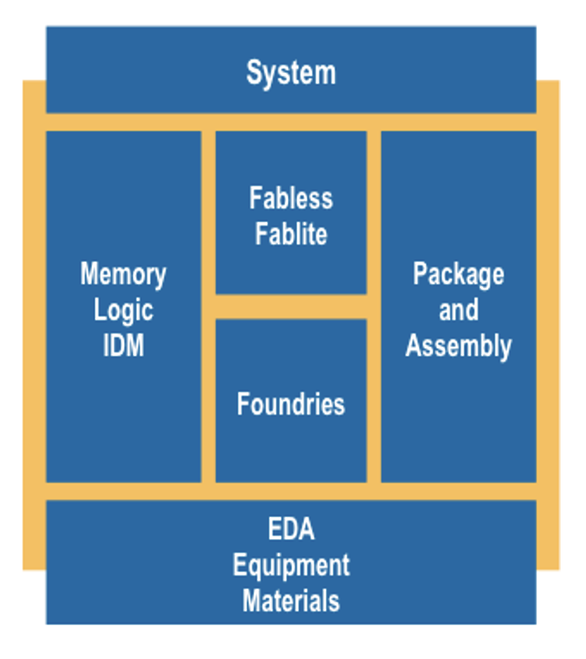
China export controls and trade restrictions
| 2019 | 2020 | 2021 | 2022 |
US only Global
Huawei 5G network chips
HiSilicon products to Huawei
Nvidia/AMD AI class processors
SMIC foundry
below 10nm
All fabs, then YMTC
US made equip and EDA
ASML EUV Lithography
EDA for GAA
All advanced fabs

Slide 20
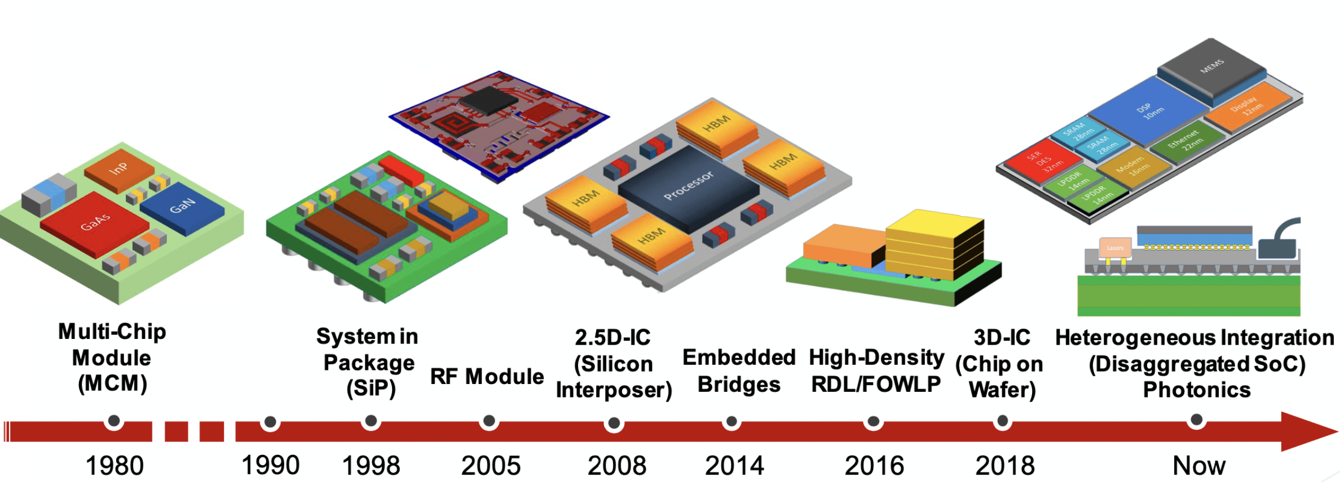
Chiplets and heterogeneous integration
Why now?
Yield loss from reticle size die
Optimize intended function to best technology node
It works: Xilinx FPGA, AMD CPUs, Intel, DARPA CHIPS
Challenges
Chip to chip interfaces: AIB or BoW or UCIe
Business model: KGD
Marketplace of available chiplets
Source: Synopsis

Slide 21
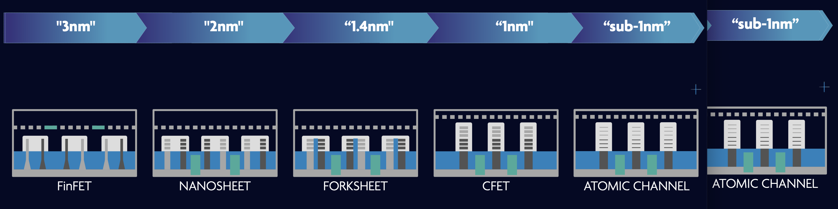
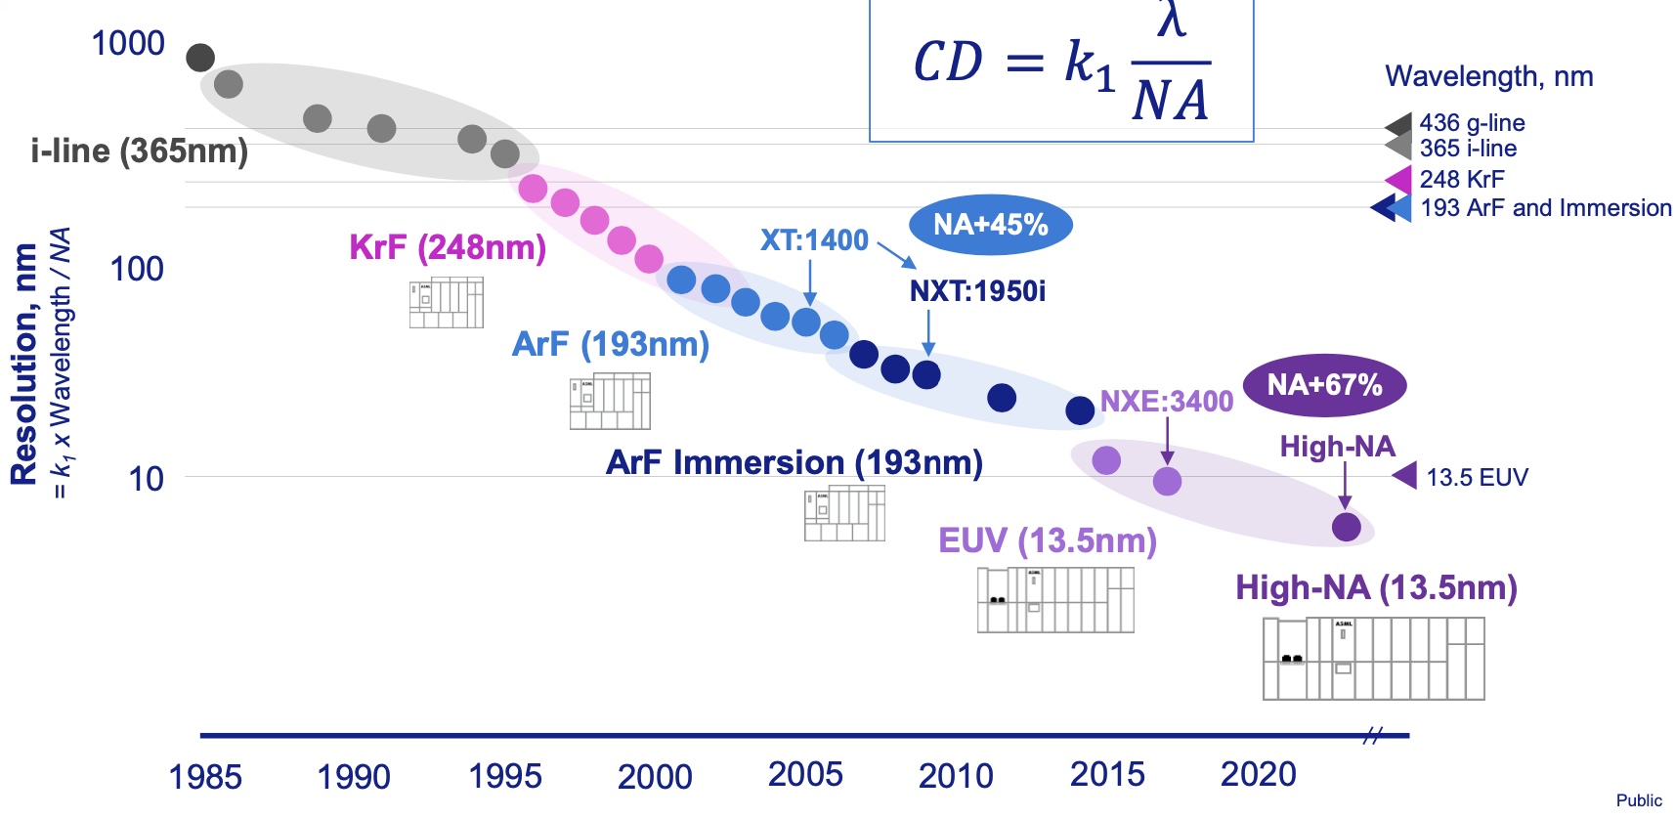
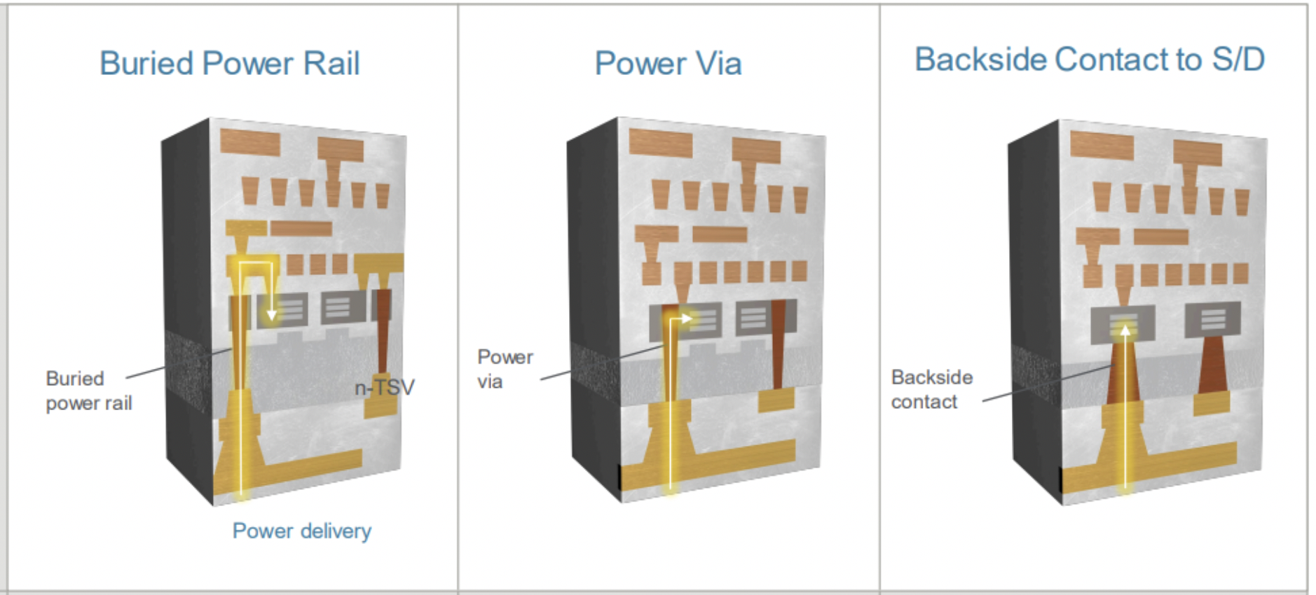
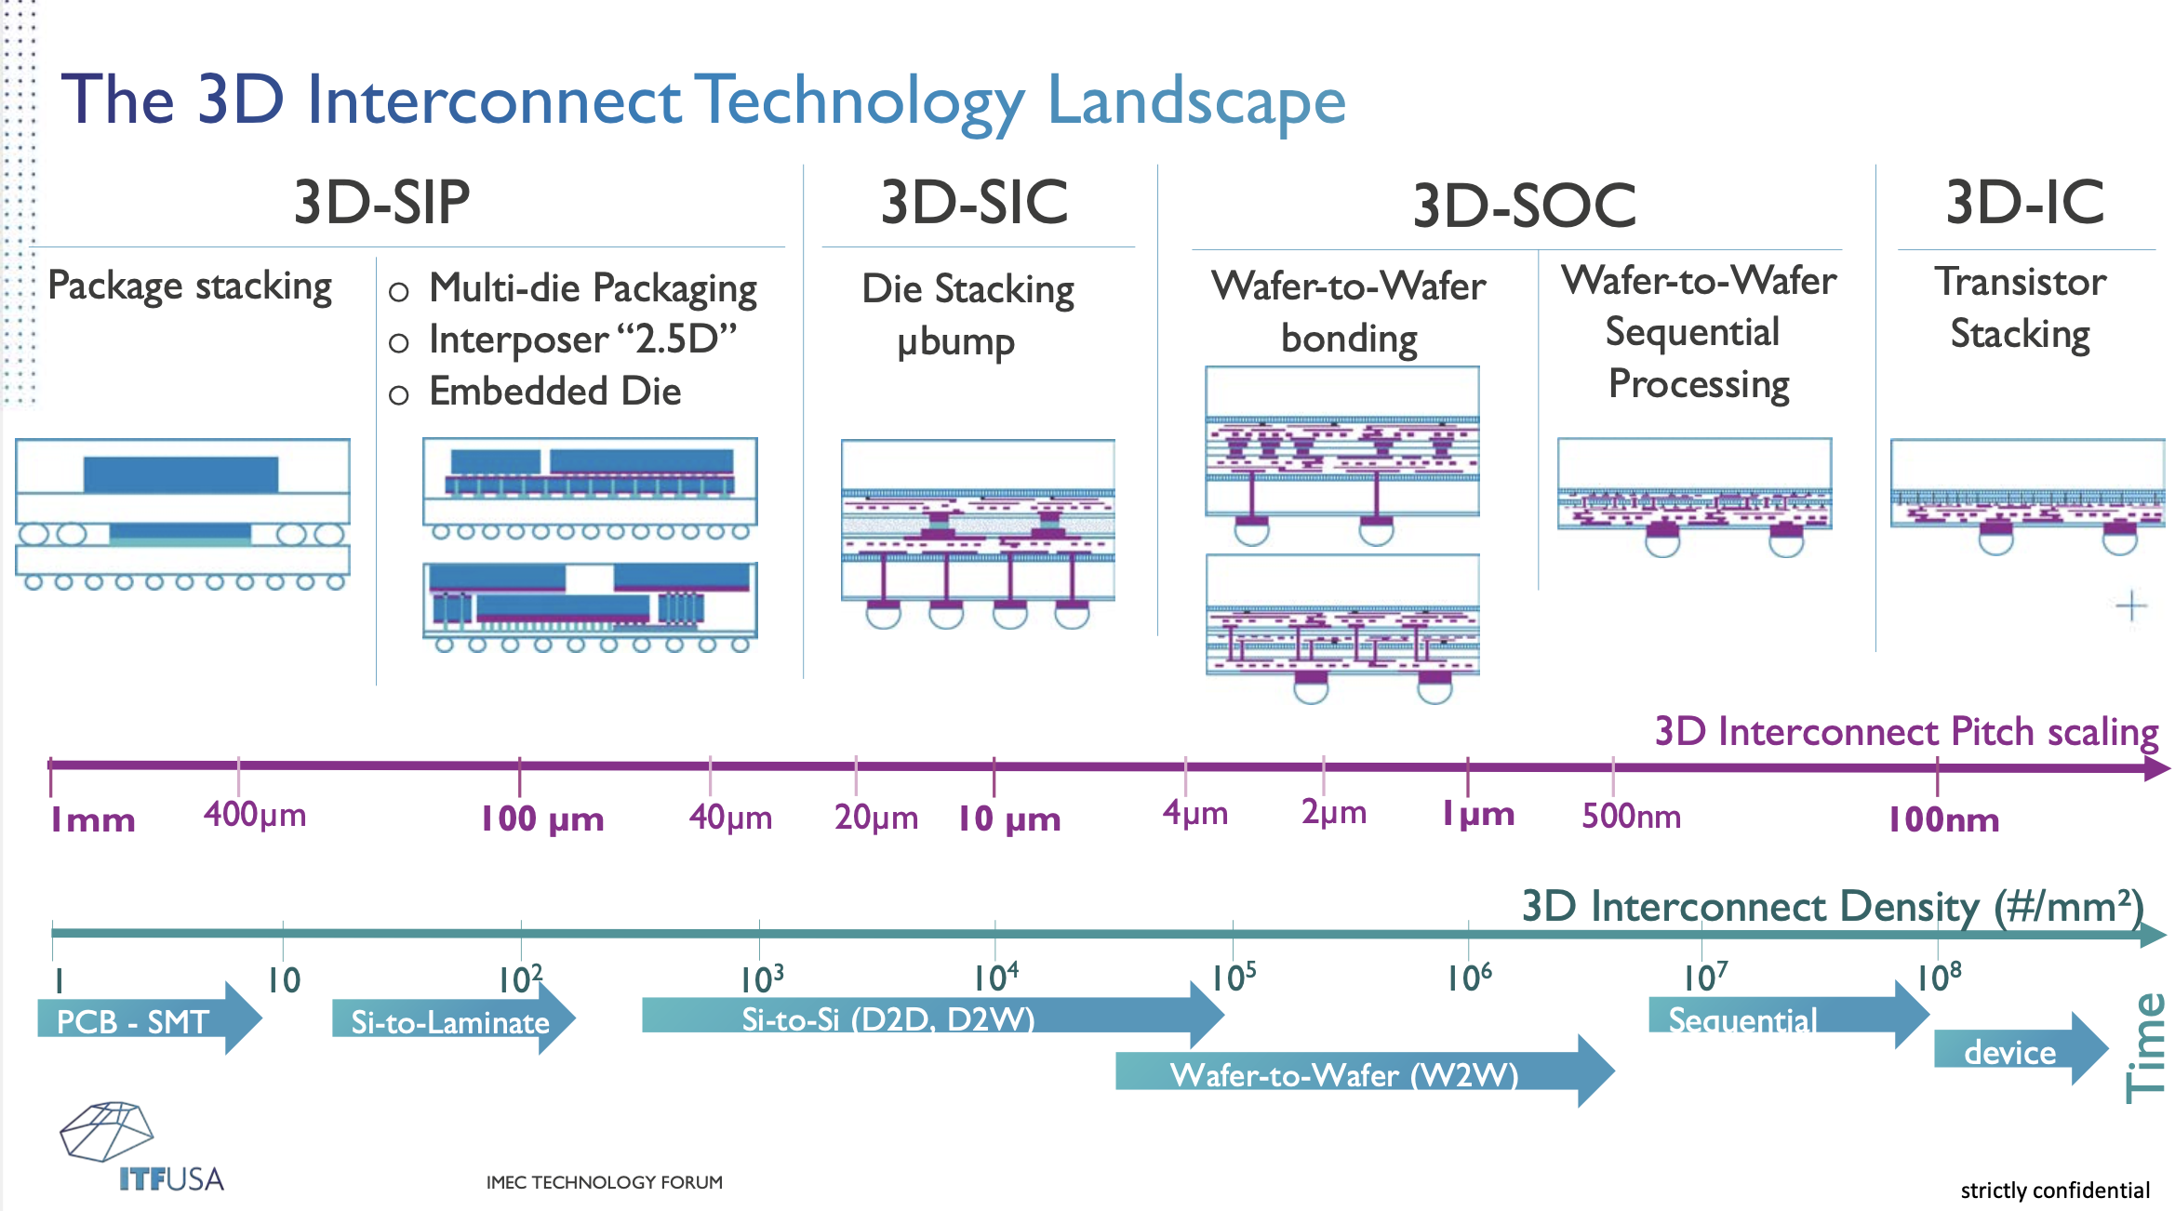
Some consolation until the next new thing: solid roadmap for next decade
CMOS Roadmap to <1.0 nm
EUV Lithography
Backside Power Distribution
Advanced packaging
Source: IMEC, ASML, IMEC, Applied Materials (clockwise)

Slide 22
Expanding the computing volume
Advanced Packaging
3DHI
Package Aggregation
(Chiplet ecosystem)
2D+
Elec IO
HBM
3D
Opt IO
Die disaggregation
2.5D
2D
Moore’s Law Scaling
(Tx Count and Perf.)
FPGA
1K
1M
1B
1T
CPU / ASIC
~3 Doublings left in CMOS
Beyond CMOS
GPU
CUDA/PYTORCH
DNNs
Algorithms and Specialized Architectures
w/ software stack
D. Armbrust 11/22

Slide 23
Forces shaping future industry evolution
System firms become silicon houses
Domain specific architectures
Intel’s entry into foundry
China
Chiplets and heterogeneous packaging
CHIPS Act
Future
?

Slide 24







The innovation gap
Semiconductor Industry
$1.5B – 5 yrs
nCORE
GAPS
Prototyping at scale
Scale-up business model
Startup funding
Gov. agency coordination
$200M – 5 yrs
BES
MRSEC
STSC
20 years 15 10 5 0
TRL1 TRL9

Slide 25
Advanced computing framework – 2018 Creating a public – private partnership
Public – Private Partnership: Industry + Academia + National Labs
3 Centers created through open National competition
5 years - $2-3B – Cost share with Industry / State Gov’t
Program themes and funding – Access to user facilities – Prototyping – Innovation Center
Industry
Software
Systems
Fabless
Packaging
S/C Mfg
Design Tools
Equipment Materials
Simulation / Modeling
Software / Algorithms
Computer Architecture
Chips
Circuits
Devices
Materials
Roadmaps – Pathfinding - CoDesign
Science of Scaling
User Facilities
HPC Centers
Prototyping Partnerships
Beamline Access
Materials Facilities
Entrepreneurs
Startup Accelerator
Gov’t Agency SBIR / SBV
Early Stage Incubation
Governance: DOE - DARPA - DOD - NSF - NIST - ARPA-E - NIH
Featured at Council on Competitiveness Advanced Computing Workshops sponsored by NSF in 2018-2019 (San Diego, Austin, Wash DC)

Slide 26
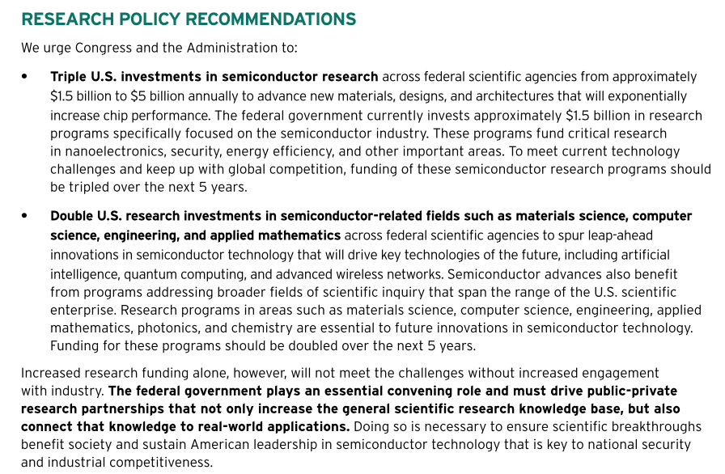

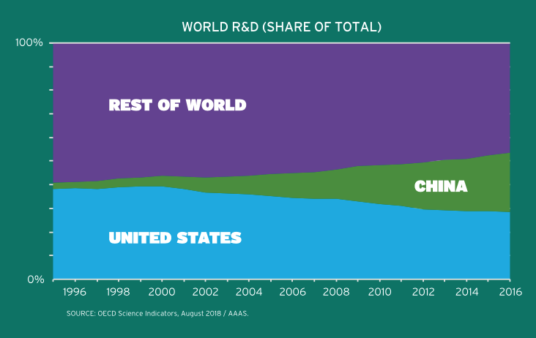
SIA report – 2019 Advocates for increased research
Source: SIA

Slide 27
SRC Decadal Plan – 2021 “Grand Challenges”
Source: SRC

Slide 28
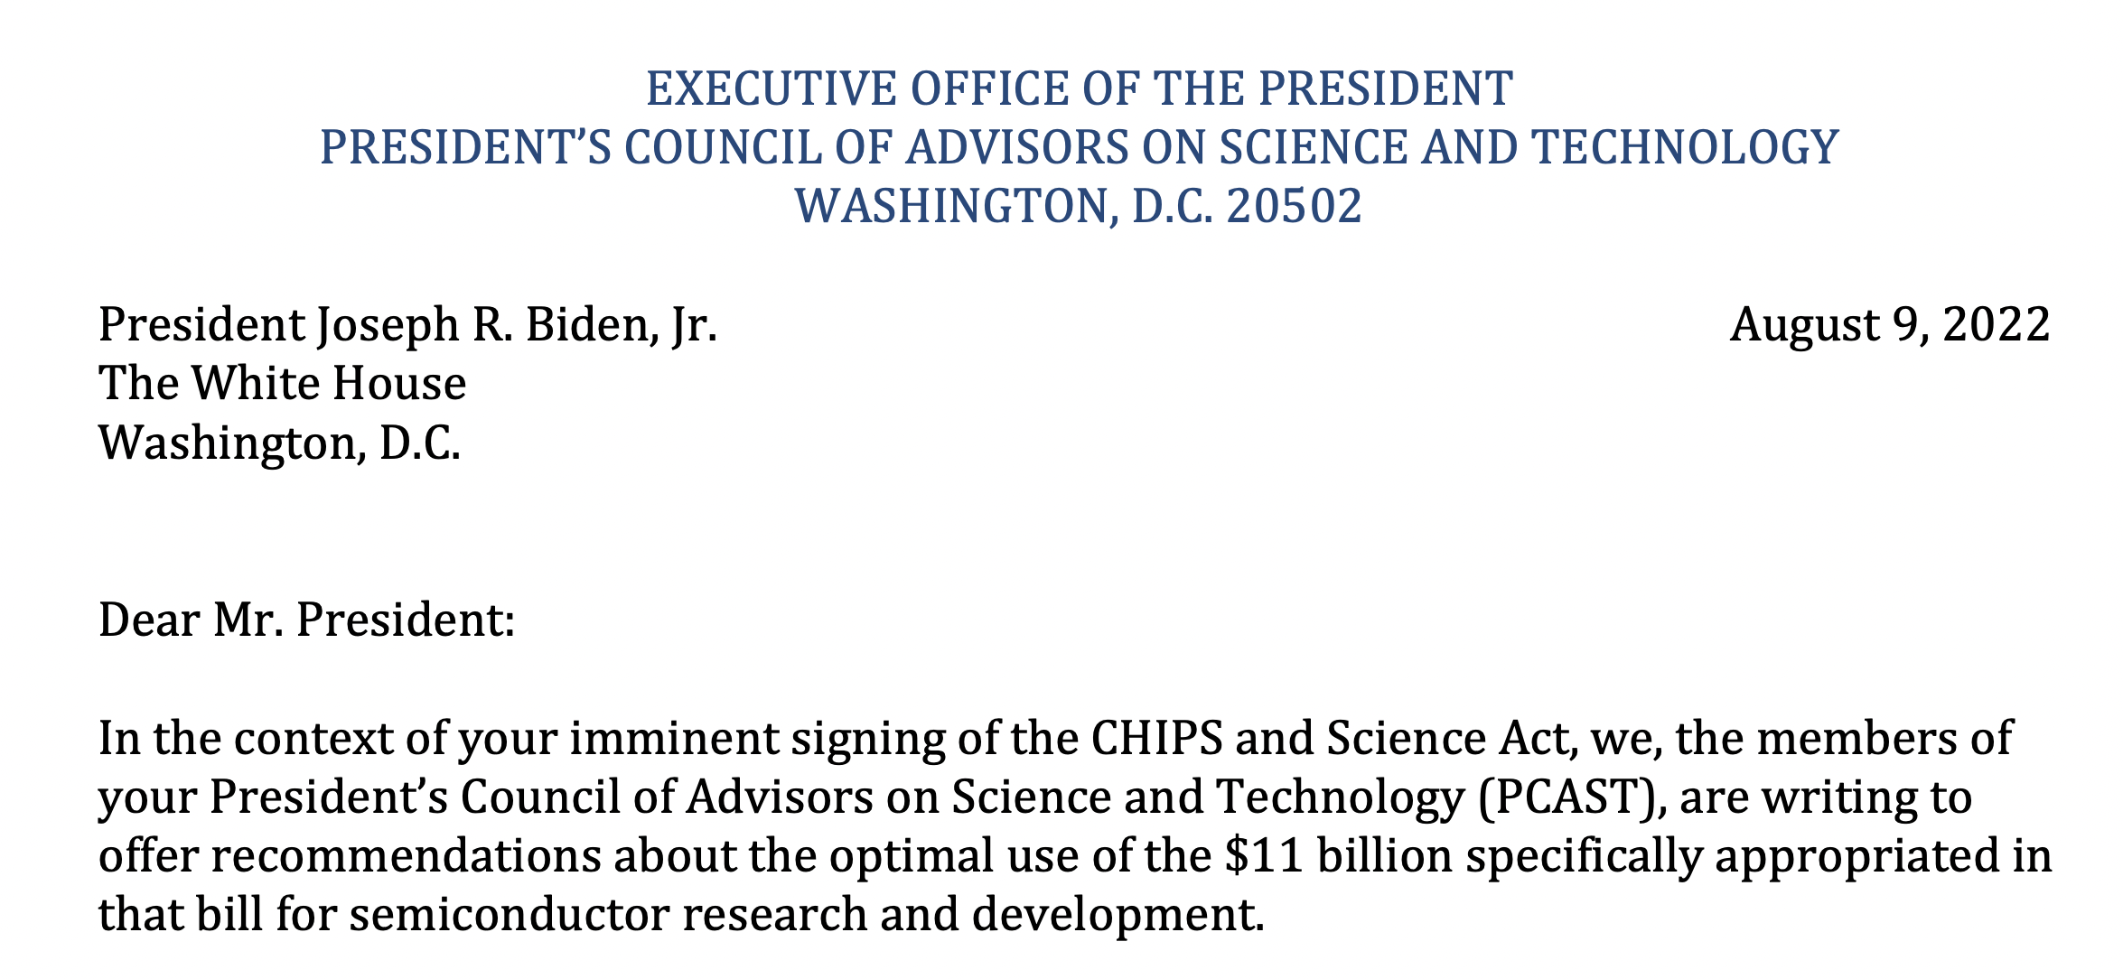
PCAST reports – 2017, 2022
“… (iii) help capitalize transformative semiconductor innovation over the next decade. Delivering on this strategy will require cooperation among government, industry, and academia to be maximally effective.”
Source: PCAST

Slide 29
Connection between R&D and manufacturing
“Without scaling, we don’t just lose jobs – we lose our hold on new technologies. Losing the ability to scale will ultimately damage our capacity to innovate.”
Andy Grove

Slide 30
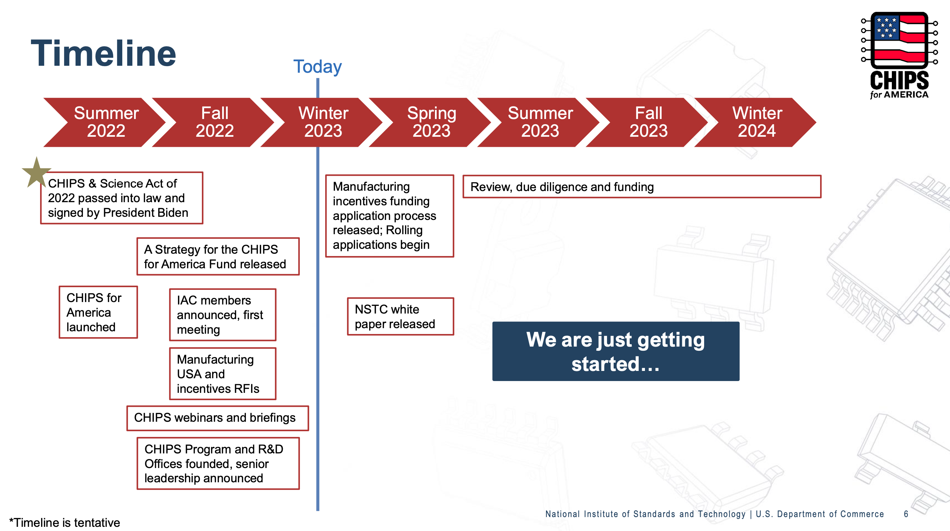
CHIPS Act Implementation

Slide 31
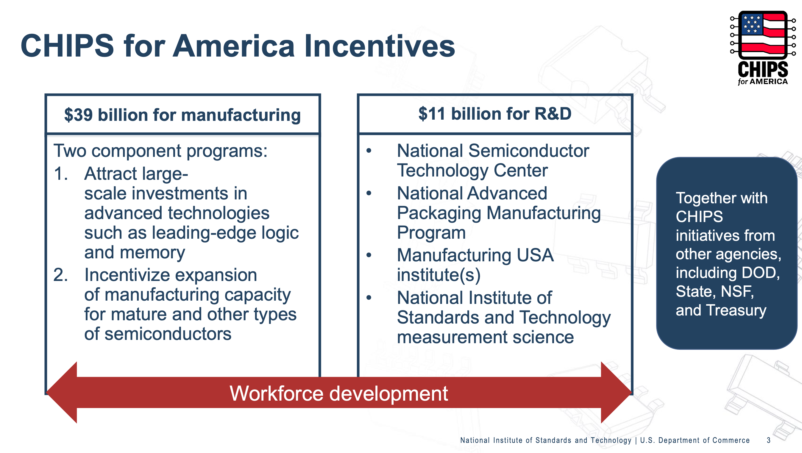
CHIPS Act Incentives
$2B DOD Commons

Slide 32
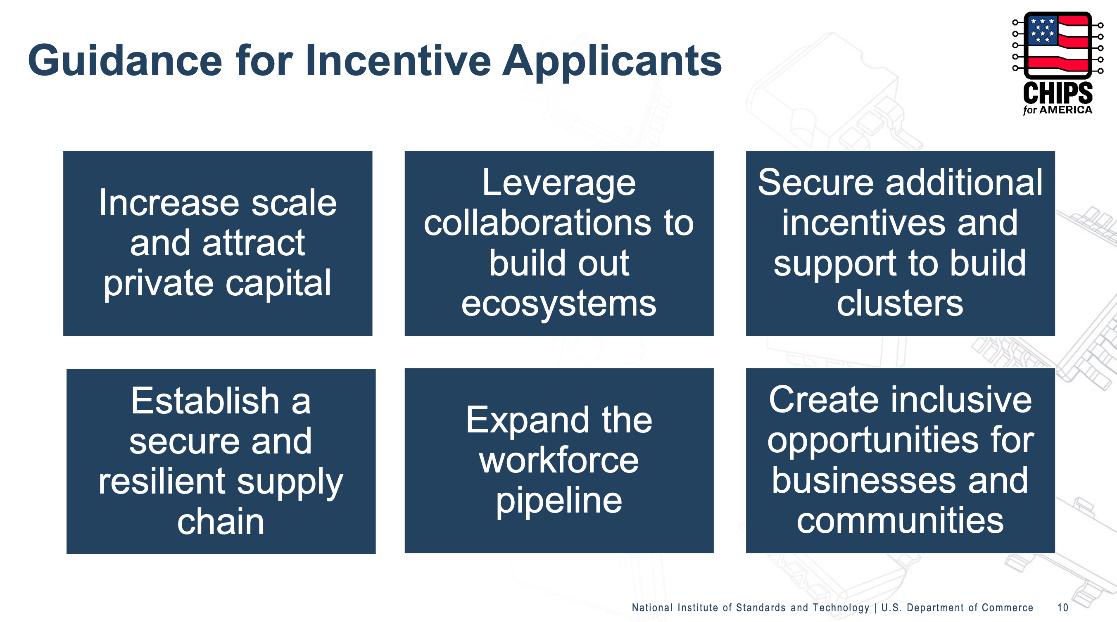
CHIPS Act: Manufacturing incentives

Slide 33
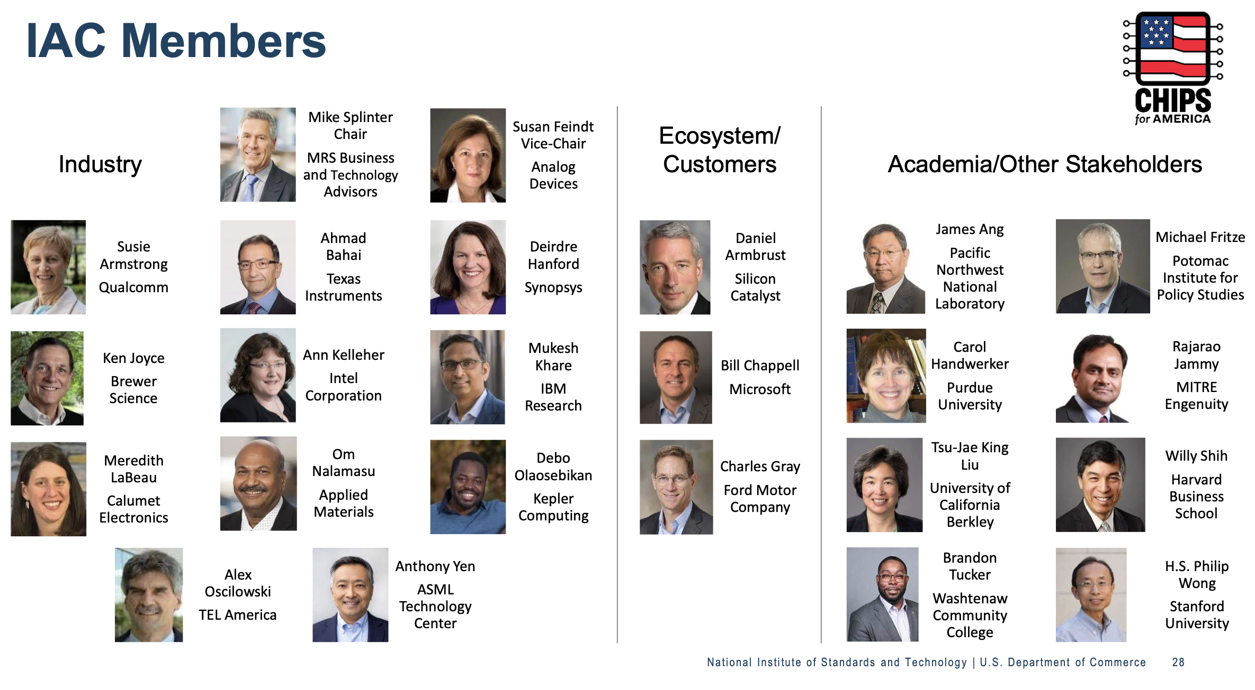
CHIPS Act Industrial Advisory Committee (IAC)

Slide 34
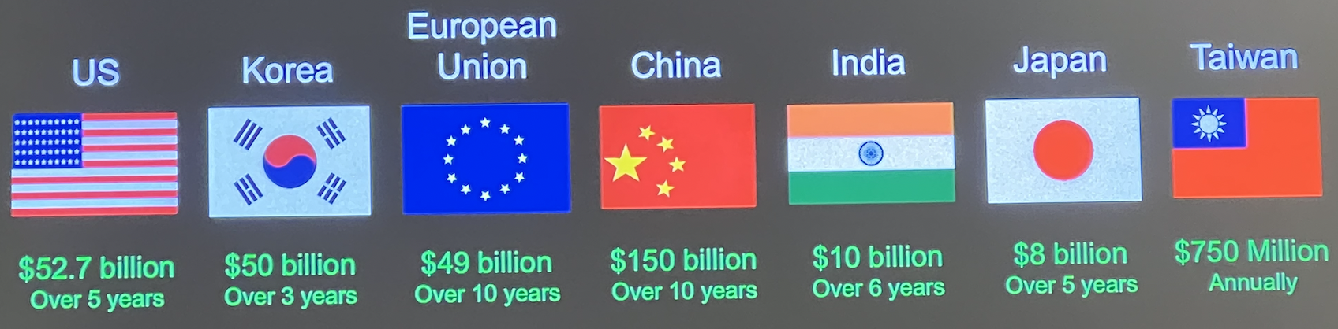
Global investments in semiconductors
Source: Synopsys

Slide 35
Chiplet community: Where can you play?
Domestic supply chain
and manufacturing
Startups
CHIPS Act
NSTC, NAPMP,
Mfg USA, DOD Commons
Incentives, Funding, Prototyping, Infrastructure, Collaboration, Jobs
R&D
EDA, 3D HI, Co-design
Ecosystem
Standards, Roadmaps, Open Market

Slide 36
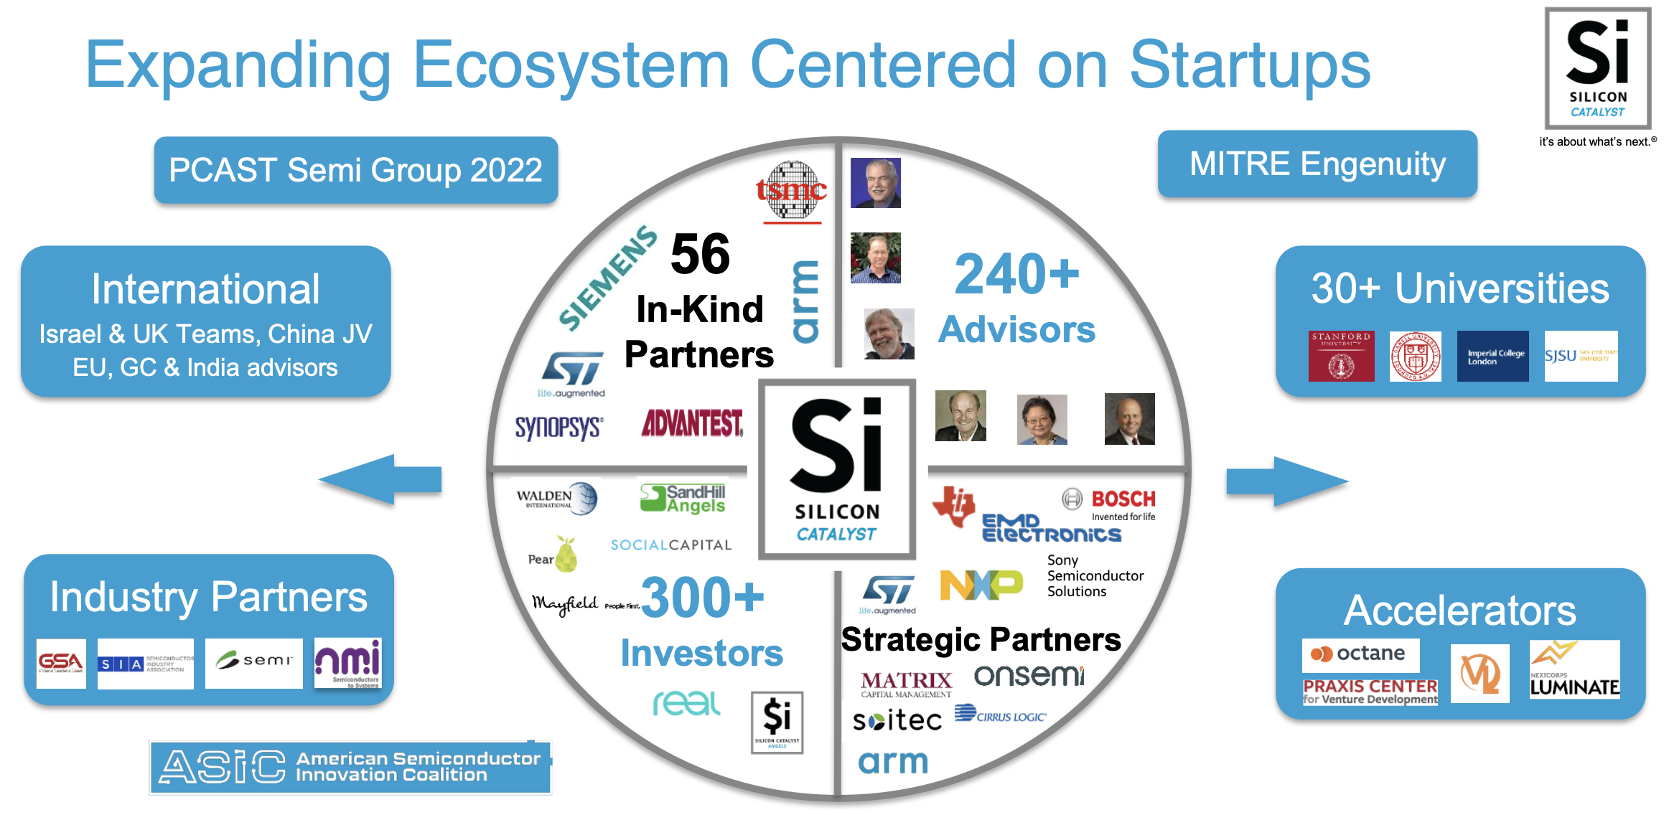
Silicon Catalyst – new (2015) semiconductor startup accelerator
Over 80 startups – portfolio >$1.5B valuation, >$400M raised
Source: Silicon Catalyst

Slide 37
Thank you
dan@sicatalyst.com

